Slide 1
Socio-economic challenges of the decarbonization of heating and cooling
DeCarbCH Lunch Seminar
5. October 2021
Matthias Speich, Sarah Hafner, Silvia Ulli-Beer
ZHAW, Institute of Sustainable Development

Slide 2
Agenda
Introduction: The decarbonization challenge from a socio-technical perspective
The business model and ecosystem concepts and their role in the energy transition
Our methods: participatory, iterative elaboration of solutions
«Sneak peek» of our ongoing study SERENDIP on decarbonization of industrial process heat

Slide 3
Our role in SWEET-DeCarbCH
Techno-economic system optimization
Legal framework and solutions
Technologies for energy conversion, distribution and storage
WP01
WP02 (ZHAW-ZOW)
=> Lunch seminar on legal aspects: TBD
WP03, WP04, WP05
Socio-economic aspects
Case studies
WP02 (ZHAW-INE)
WP06, WP07
=> How to integrate techno-economically sensible solutions in the regional energy system so as to achieve a timely implementation and sustainable operation?

Slide 4
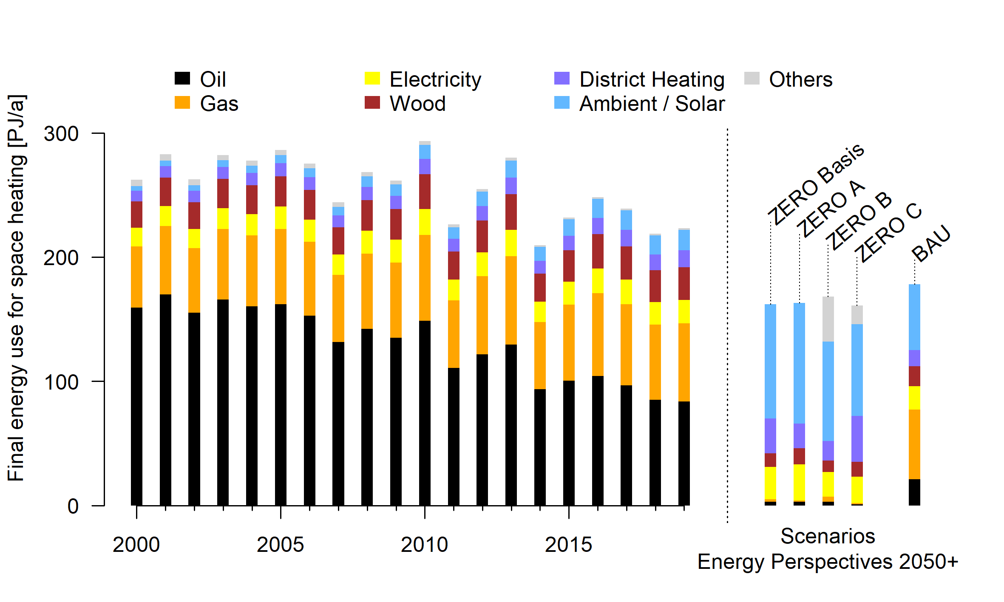
Challenges at national level: Residential heating
Over the last 20 years: sinking final energy use and less oil
But: current measures are not enough for net-zero by 2050 (cf. BAU-scenario)
EP2050+: District heating to be doubled / tripled
Data source: SFOE (2020, 2021)

Slide 5
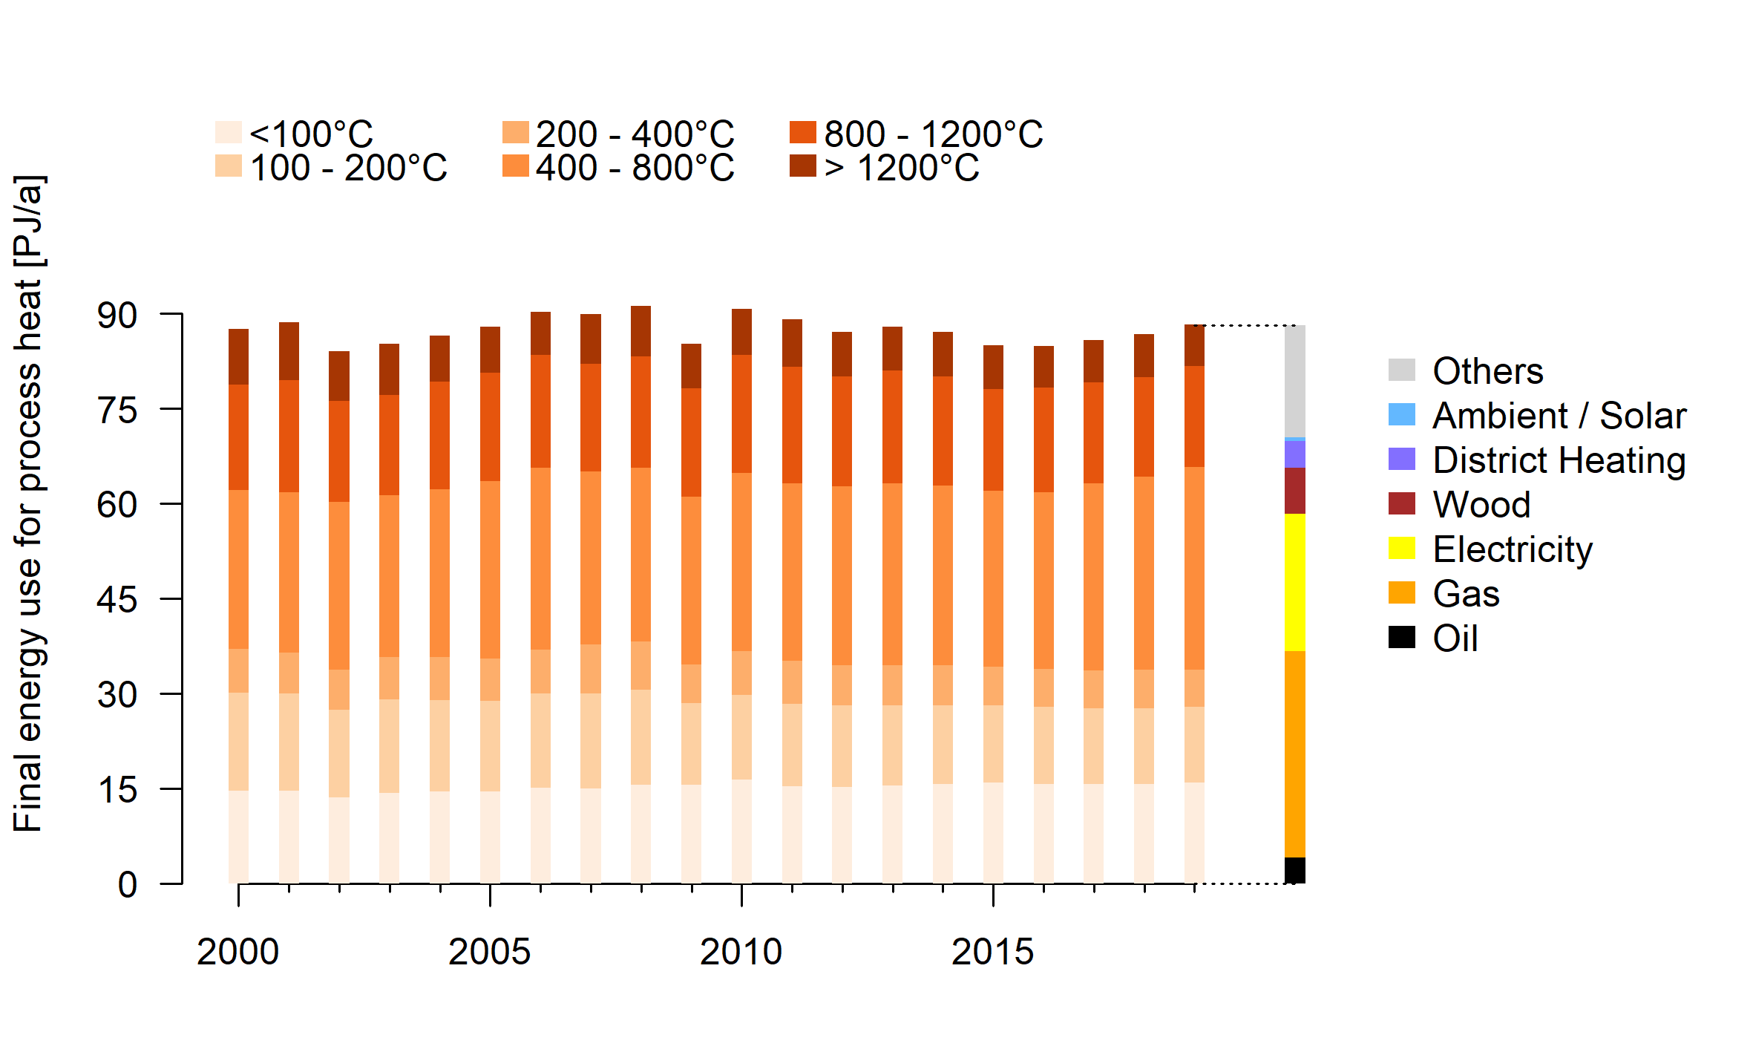
Challenges at national level: Industrial process heat
Includes 5 PJ/a coal
High temperature applications require primarily alternatives to natural gas
Lower temperatures: Large potential for heat pumps and solar thermal, but diffusion so far slow
Data source: SFOE (2020)

Slide 6
Non-technical barriers
Thermal grids
Decarbonization of industrial process heat
Informational barriers
Competing interests
Long payback time
Lack of specific know-how
Uncertain competitiveness (vs. decentral solutions)
Financial risk
Customer value ≠ Societal value
High coordination / planning effort
Low priority of energy issues
Uncertain evolution of heat demand (e.g. building retrofit)
Lack of awareness on available options
Operational / technical risks
Source: Own illustration; literature review

Slide 7






Our thematical and methodical focus areas
Value networks and ecosystems
Innovative business models
Long-term value creation
Participatory approaches
Surveys, Interviews, Experiments…
Computer simulations (System Dynamics)

Slide 8
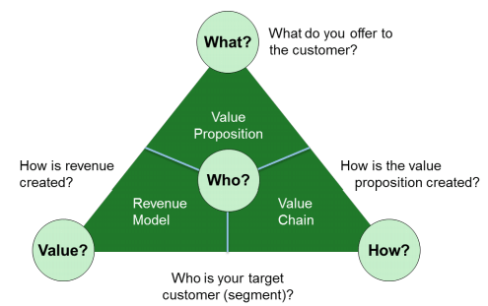
The business model concept to organize value creation
Applicable to companies as well as individual products
Subject to constant innovation to adapt to a changing environment
Not only for private, for-profit organizations: “if an organization has a viable way to create, deliver, and capture value, it has a business model” (Kaplan, 2011)
Gassmann et al. (2013)

Slide 9
The role(s) of business models in sociotechnical transitions
Existing business models as barriers to change
Business models as a device to commercialize technological innovations
Business models that are part of the existing regime reinforce its stability
“A mediocre technology pursued within a great business model may be more valuable than a great technology exploited via a mediocre business model” (Chesbrough, 2010)
Business models as complementary, non-technical innovations
New business models challenge the dominant regime logic, and can accelerate the diffusion of new technologies
after Bidmon & Knab (2018), Geels et al. (2017)

Slide 10
Limitations of the business model concept
A BM focuses on value creation by a single organization
=> Which contributions can (BM) research make in cases where…
  - Value creation depends on the interactions of several, independent organizations?
  - Value is created for end customers as well as for society?
  - Systemic innovations are required?

Slide 11
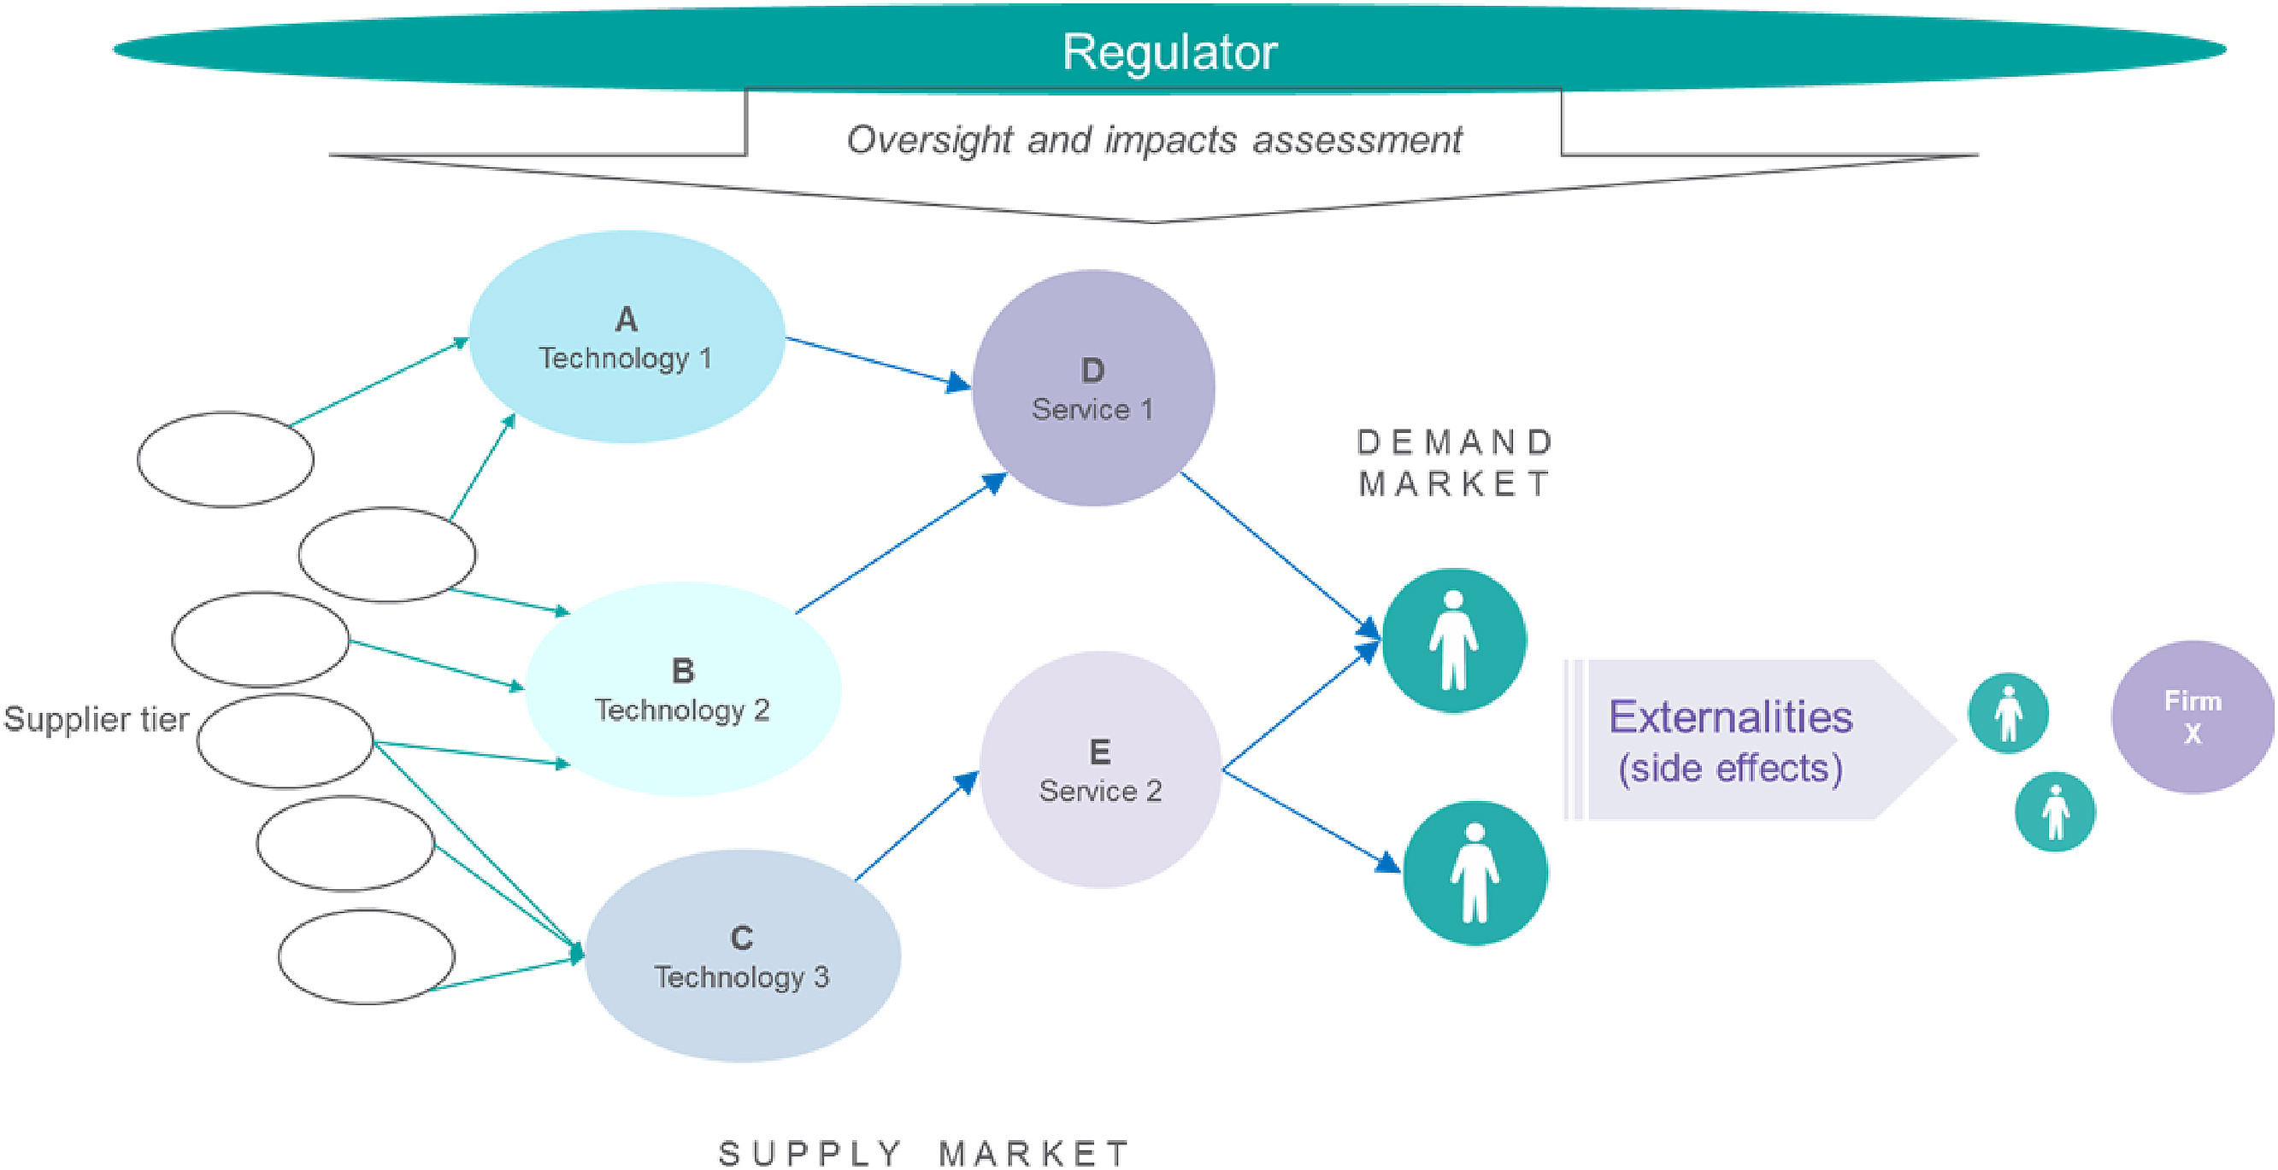
Business / Innovation ecosystem
Purposeful, orchestrated collaboration within a value network to realize a specific value proposition
Public-sector actors are explicitly included as:
  Regulator
  Active participant of the value creation process (possibly as orchestrator)
  Representative of societal interests
Leviäkangas & Öörni (2020)

Slide 12
Value creation on multiple levels in ecosystems
  Societal value
after Leviäkangas & Öörni (2020)
City, canton…
  Timely achievement of net-zero target
  Local / regional value creation
  Collaborative value
(Local / regional) value network
  Business value for the supply chain / partners
  Improved value proposition through pooling of know-how
  Business value
Utility / Contractor
  Profitable investments in clean heating / cooling solutions
  Value proposition
End customers
(Households, Industry…)
  Affordable, reliable, (clean) energy supply
  Reduction of planning / administrative effort

Slide 13
Our thematical and methodical focus areas
Value networks and ecosystems
Innovative business models
Long-term value creation
Participatory approaches
Surveys, Interviews, Experiments…
Computer simulations (System Dynamics)

Slide 14
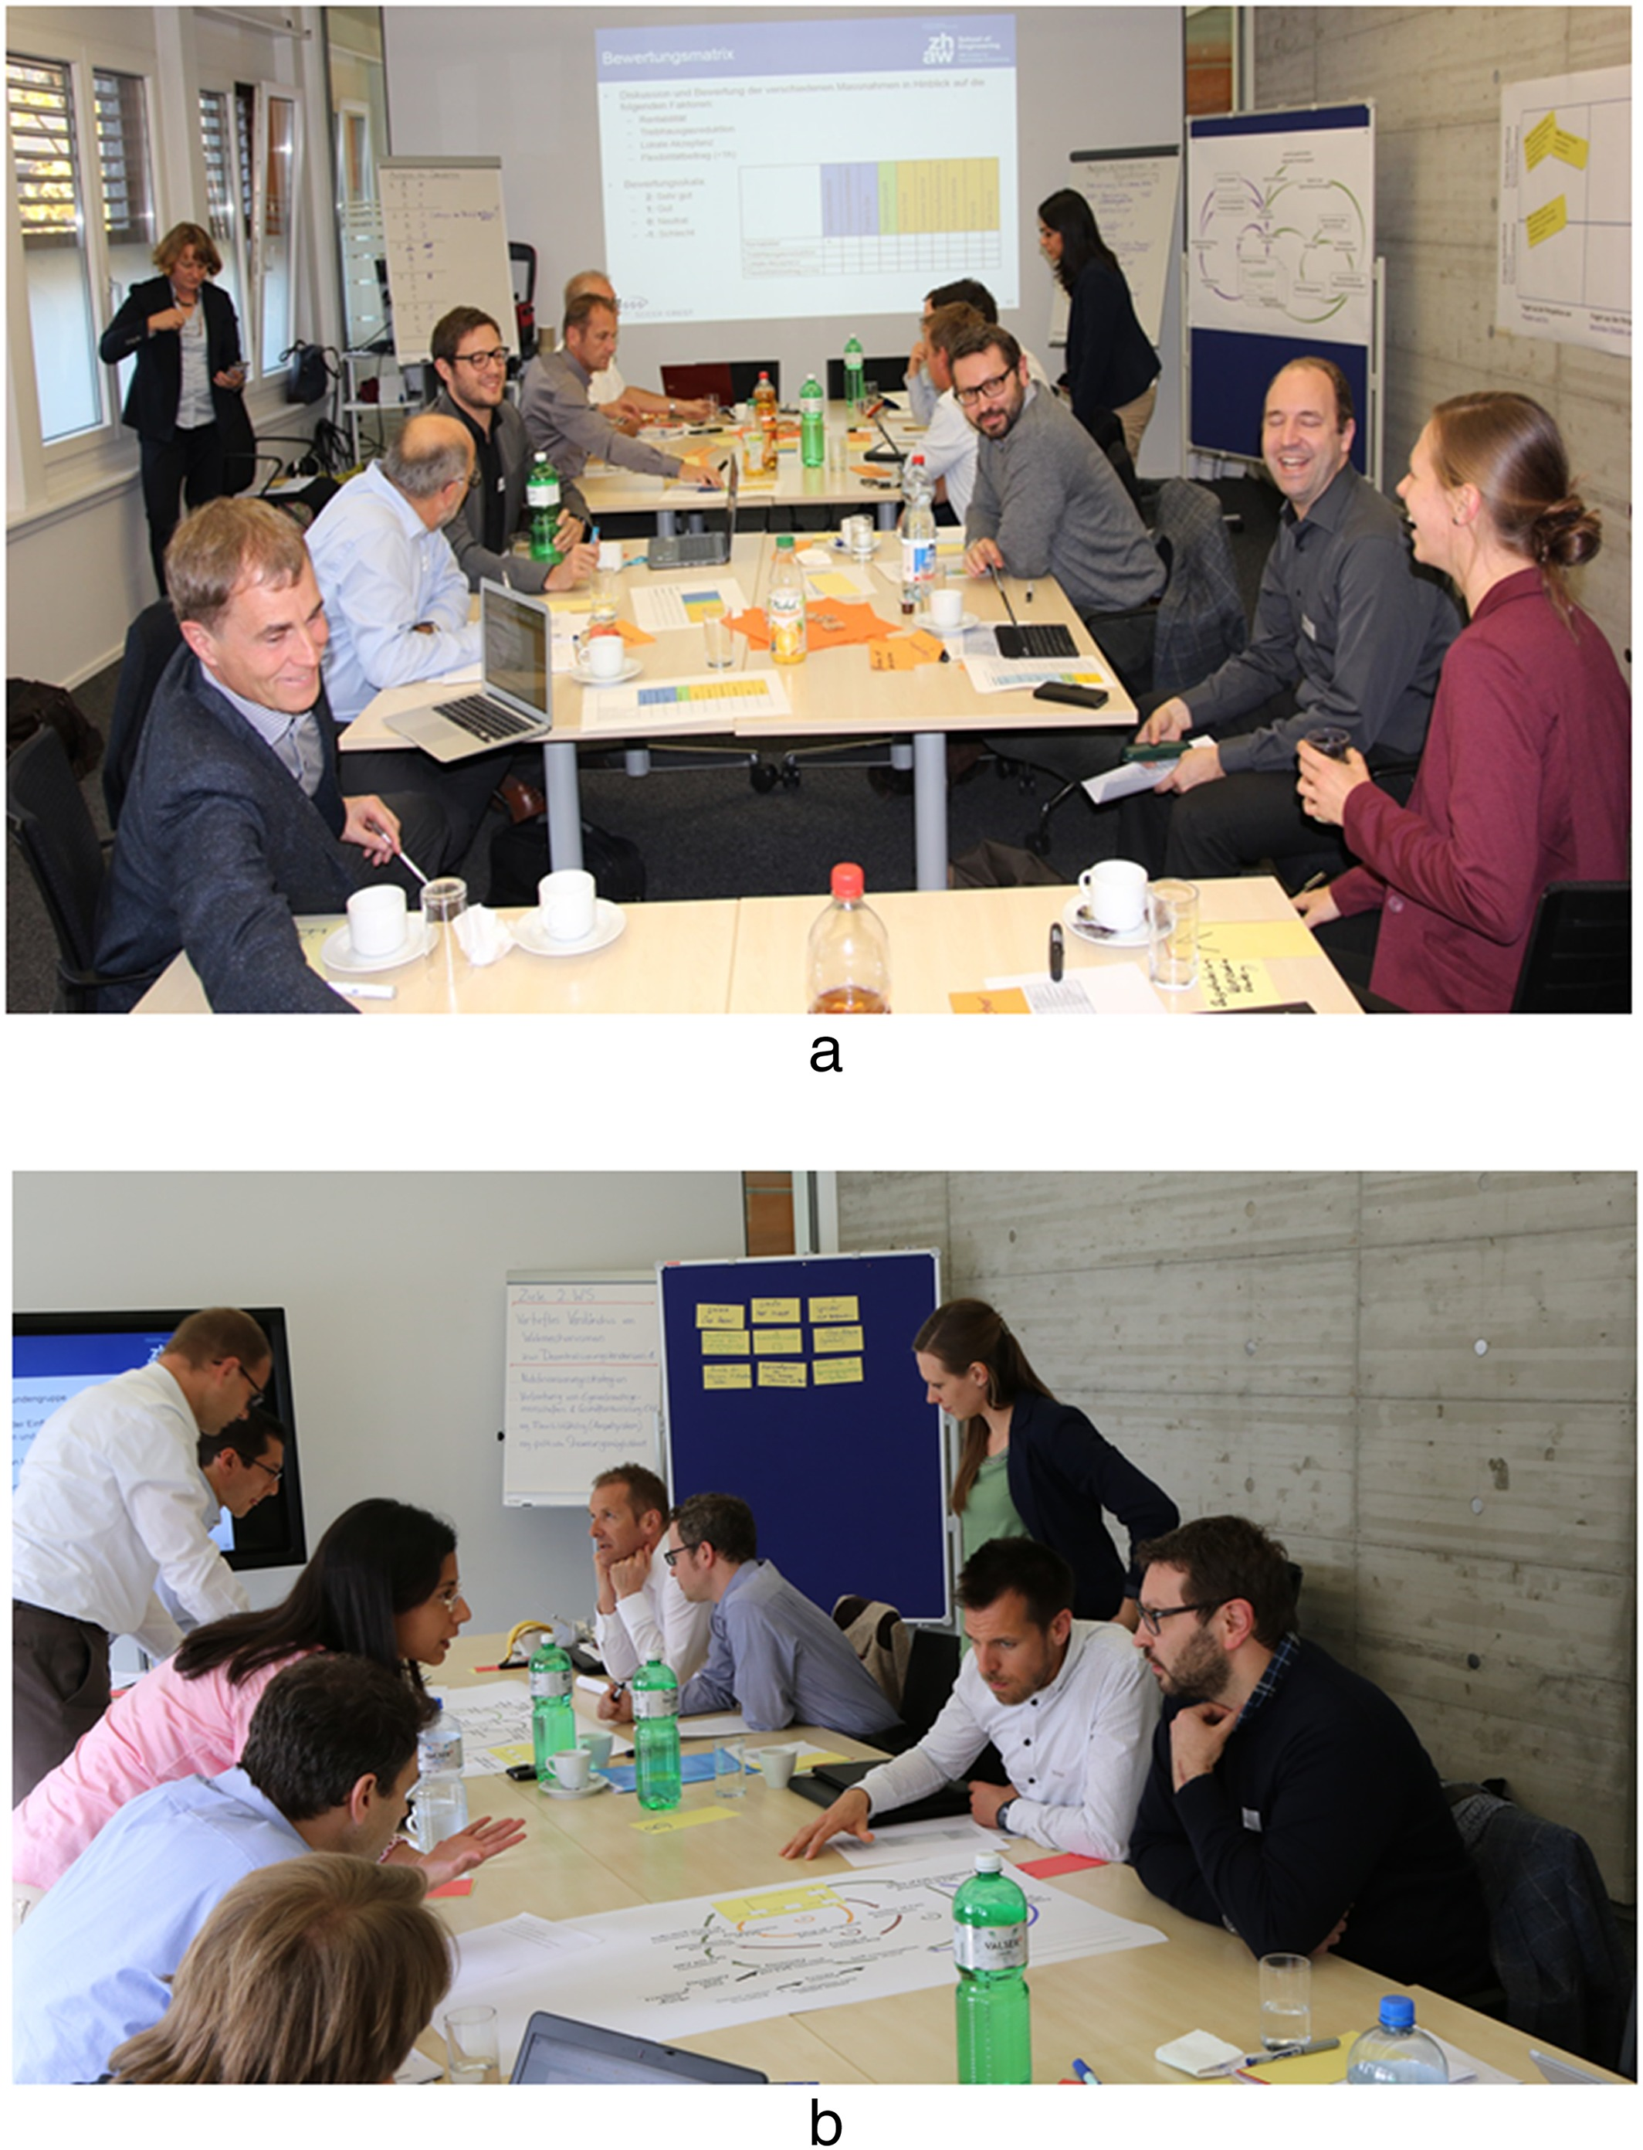
Participatory case study approaches and design science to ...
… analyze decisive actors, their roles, strategies and perceived barriers for DeCarbCH solutions
… analyze value network structure and ecosystem potentials
  Improved value proposition potentials
  Potential synergies and need for alignment between actors
… elaborate and assess innovative business models for the integration of clean heating / cooling technologies
Image source: Ulli-Beer et al. (2017)

Slide 15
Iterative learning and design process
Start of case study:
Definition of goals and case study objects
Ongoing / planned tasks of the city
Planning District A
Energy advisory program
Planning District B
Continuous monitoring and adaptation
Concrete value proposition
Governance arrangements between organizational units
…
Implementation District A
Implementation District B
after Ben Mahmoud-Jouini & Charue-Duboc (2017)

Slide 16
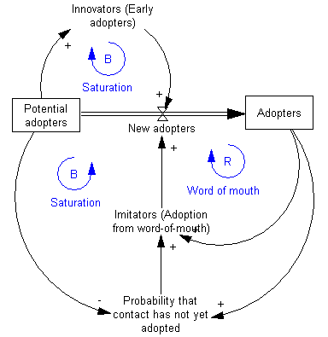
Outlook: Dynamic, model-based assessment of solution variants
Solution variants
Different business models, governance arrangements, etc.
Local context
Structural, demographic, economic parameters
Scenarios:
H/C Demand (renovation rate, new construction, climate scenarios…)
Technology and energy prices
Policies
Simulation model of the local energy system
Customer decisions
Network effects
Infrastructure requirements
Illustrative example
en.wikipedia.org
Outputs:
Evolution of relevant quantities (GHG emissions, cash flows, actor-specific KPIs…) over time

Slide 17

SERENDIP study – A sneak peek
SERENDIP: Studie zu Hindernissen und Treibern zur Dekarbonisierung von industriellen Prozessen
Internally financed study; Jan – Dec 2021
Aims:
  Understand the barriers and drivers of industrial process heat decarbonization in the specific context of Swiss manufacturing companies
  Identify the need for further instruments (e.g. policies, consulting offers) to accelerate the uptake of process decarbonization measures
Basis for a periodical survey in the future

Slide 18
SERENDIP Study Design
Definition / Assessment of sample
Population: Swiss manufacturing companies with a GHG emission target agreement
Theoretical sampling: acquire new data until information saturation is reached
Synthesize new insights for theory and practice
Known barriers and drivers of industrial decarbonization
Development of interview guide
Qualitative content analysis
MAXQDA software
Theory
(St. Galler Management model)
Semi-structured interviews
Interview partners: decision-makers (e.g. member of upper management)
Transcription of interviews
Literature review
Semi-structured interviews
Content analysis
and synthesis

Slide 19

Example for coding / content analysis
Code: Internal financing
Interview transcript
«Financing is really always the biggest challenge. … Everything works well, but we are supposed to spend on something where we don’t know if it will pay off. As a producing company based in Switzerland, we must be extremely careful»
«We also need to finance feedstocks and so on first. … Of course, we received federal support, and we greatly appreciate that. But financing is a big problem. We were able to solve it with leasing. But it’s still a lot of money that is needed.»

Slide 20
Take-home message
Decarbonization of heating and cooling provides value creation opportunities to citizens, businesses, state and society
To realize these, new forms of orchestrated collaboration and new business models are required
  Value creation on different levels will be studied from an ecosystem perspective
Elaborating organizational solutions to transform the energy system is a continuous learning and design process
  We offer a science-based, iterative approach to learn from ongoing work and devise the next steps (design science)
  Close collaboration with practical partners and technology-oriented research partners

