Slide 1


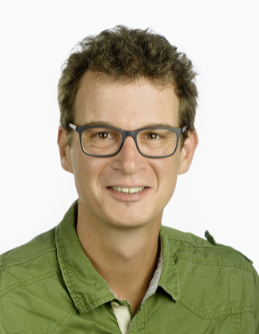

Thermal Networks – Challenges and Outlook
Tobias Sommer, Senior Research Associate, HSLU
Notes:
Tobias Sommer
Senior Scientest at the University of Applied Sciences in Lucern, Insitute of Building Technology and Energy
Within DeCarbCH leading WP3 on «Technologies, design, and operation of thermal grids for future energy planning”

Slide 2
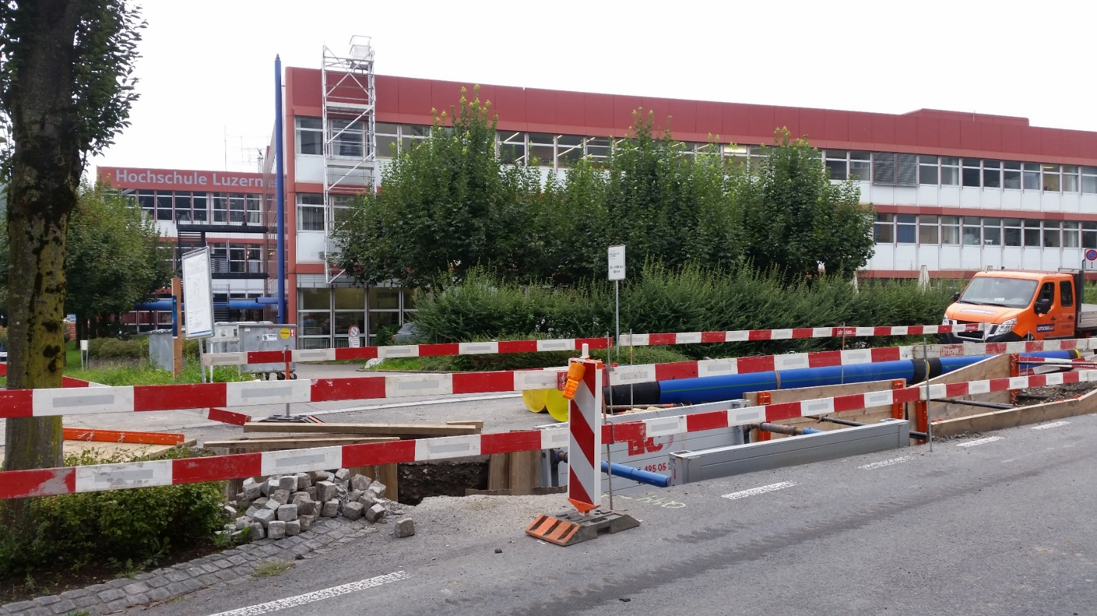
Notes:
Pic from Summer 2019

Slide 3
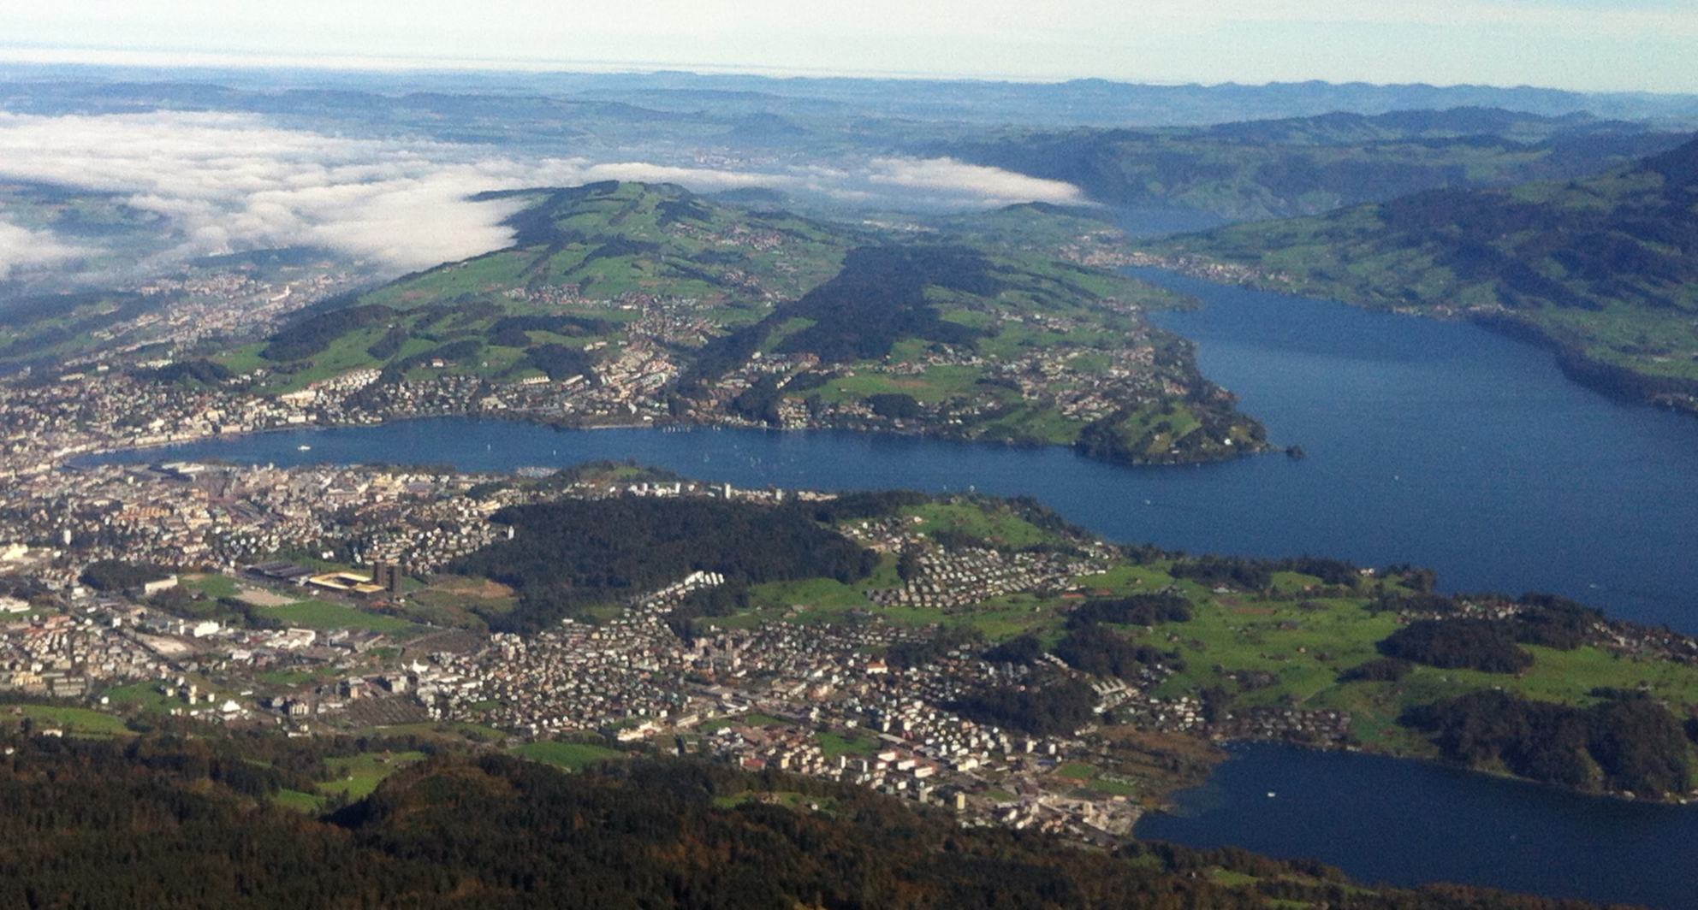
Luzern

Slide 4
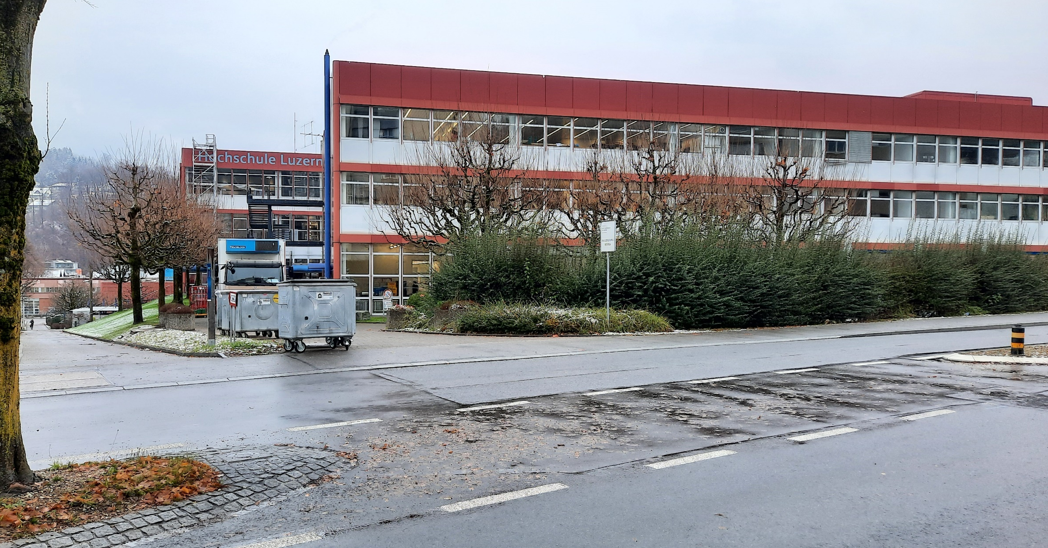

Slide 5
Structure:
Decarbonisation potential of thermal networks in Europe and Switzerland
Network designs for district heating and cooling

Slide 6
«Heating and cooling are using almost
50 % of final energy demand and are responsible for approximately
36 % of CO2 emissions in the EU»
EU. DIRECTIVE (EU) 2018/844 OF THE EUROPEAN PARLIAMENT AND OF THE COUNCIL of. n.d.
European Commission. An EU strategy on heating and cooling. 2016.
Notes:
Picture of EU

Slide 7
Decarbonisation potential of thermal networks in CH
Total emissions CH (CO2eq)
46 Mt
BFE. Energieperspektiven 2050+:Kurzbericht. Bundesamt für Energie BFE; 2020
Buildings (fossil heating)
11 Mt (24 %)
Jakob M, Reiter U, Catenazzi Dr. G, Lienhard L, Müller A, Steinmann S, et al. Erneuerbare- und und CO2-freie Wärmeversorgung Schweiz - Eine Studie zur Evaluation von Erfordernissen und Auswirkungen 2020.
Insulation/Refurbishment
≈ 5 %
7.5 Mt
Thermal Networks based on
renewables
Δ 2.5 Mt
5 Mt
Individual solutions based on renewables
Chambers J, Narula K, Sulzer M, Patel MK. Mapping district heating potential under evolving thermal demand scenarios and technologies: A case study for Switzerland. Energy 2019
≈0
Sres A, Nussbaumer B, Eicher H. Weissbuch Fernwärme Schweiz - VFS Strategie. 2014.
BAFU. Kenngrössen zur Entwicklung der Treibhausgasemissionen in der Schweiz 1990-2018. Bundesamt für Umwelt BAFU; 2020.
Notes:
Picture of Switzerland, and reduction to buildings only
Maybe add references to Sres, Chambers
Say insulation decreases emissions by 30 %
Say district heating can cover 30 % of the future heating demand.
After the insulation refers to 2050.
Then Sres states 38 %
Chambers 53 %.

Slide 8
District heating can reduce total CO2 emissions of Switzerland by approximately 5 %.
(5 % of current CO2 emission,
cooling not considered)
Notes:
Assumption:
Where can we put distric heating, exclusively by renewables.

Slide 9
Share of district heating
Share of renewables

Slide 10
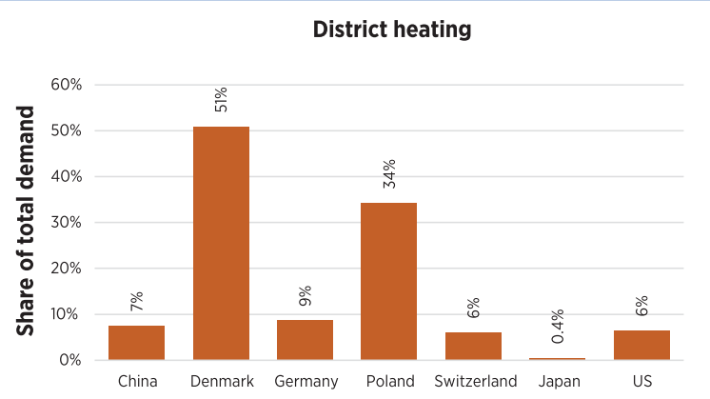
Increase by
factor 2 to 3
realistic
to 9 %
IRENA. Renewable energy in district heating and cooling: A sector roadmap for REmap. Abu Dhabi: International Renewable Energy Agency; 2017.
FernwärmeSchweiz. Jahresbericht 2020. 2021
BFE. Schweizerische Gesamtenergiestatistik 2019. Bundesamt für Energie BFE; 2020.

Slide 11
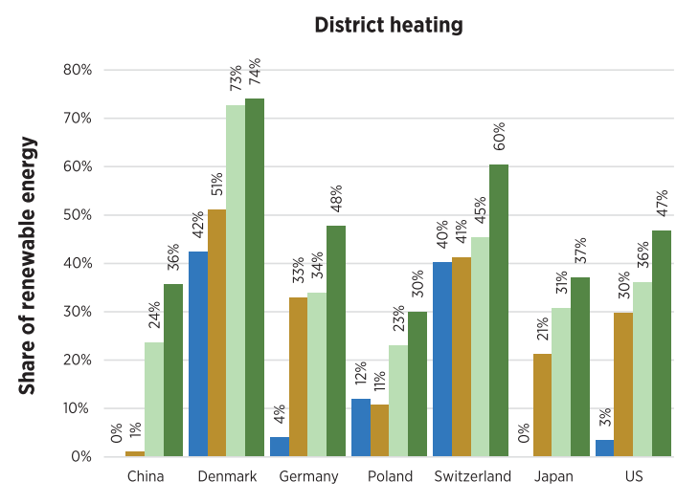
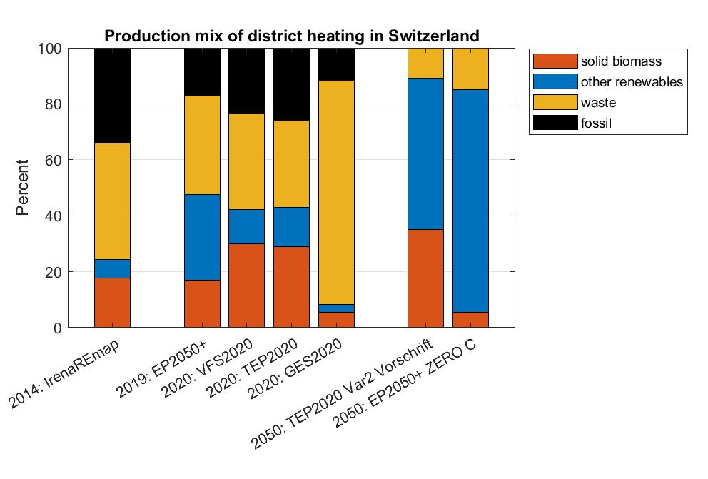
IRENA. Renewable energy in district heating and cooling: A sector roadmap for REmap. Abu Dhabi: International Renewable Energy Agency; 2017.
Notes:
Biodradable Waste is included but no waste chp
In Fernwärme Schweiz: 37 % but KVA (34.5 %) not included

Slide 12
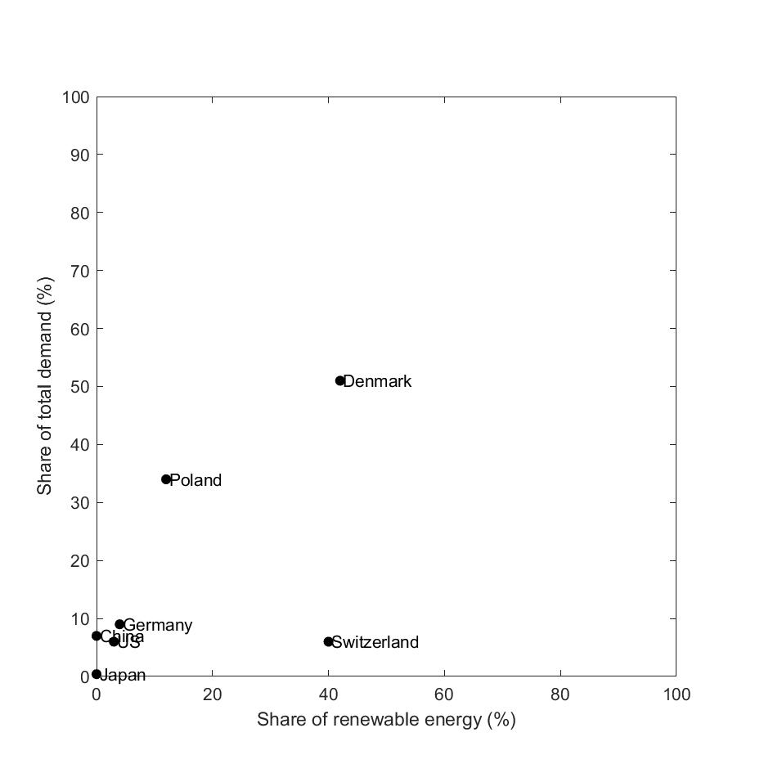
Build more networks
Temperature reduction
Notes:
Sres: Increase from 3.4 to 17 TWh
Text CAS Thermische Netze: from 6 to 30 TWh, in the end
Currently 5.4 TWh in district heating (Gesamtenergiestatistik, Chambers), Sres says 3.3 TWh

Slide 13
Factor of 2 to 3 increase in district heating realistic for Switzerland
Build more networks
Temperature reduction
Notes:
Sres from 3.4 to 17 TWh
Chambers from 5 to 25 TWh

Slide 14
DeCarbCH, WP03
Technologies, design, and operation of thermal grids for future energy planning

Slide 15
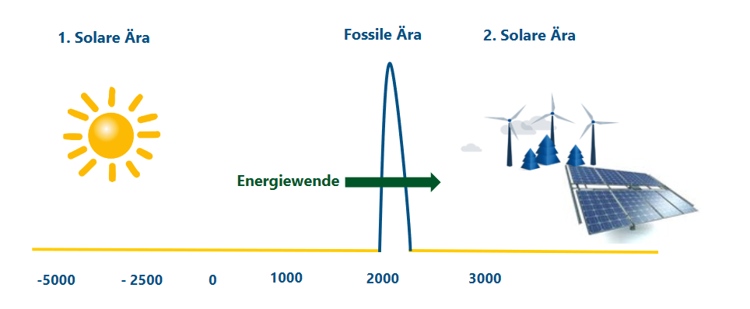
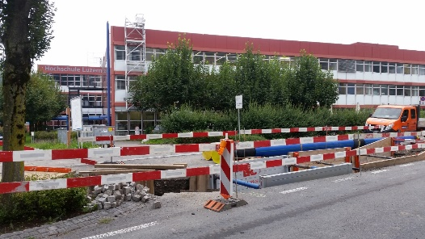
Patrik Rust, EWL

Slide 16
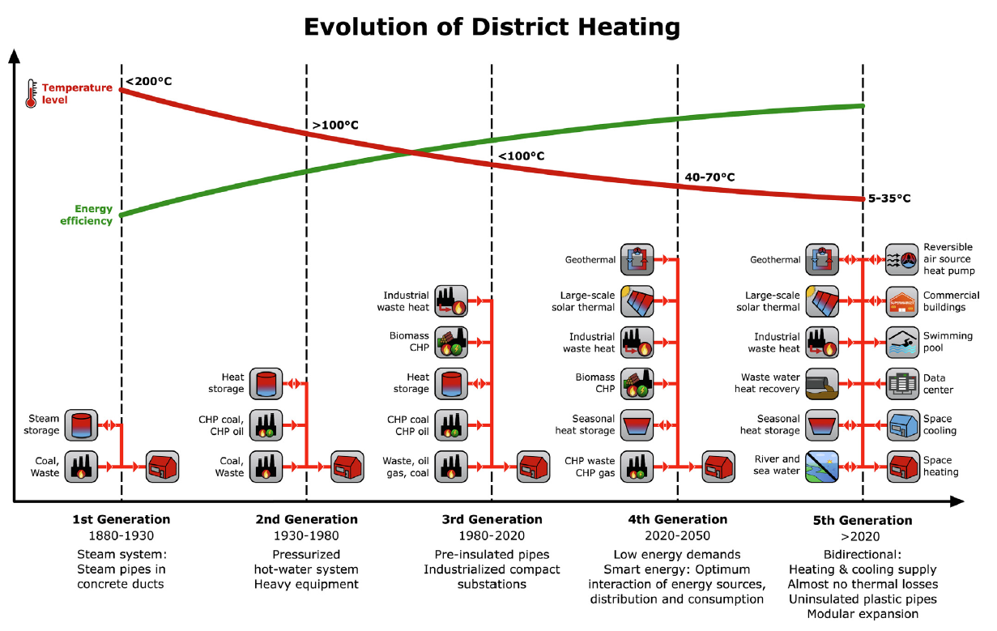
Wirtz M, Kivilip L, Remmen P, Müller D. Quantifying Demand Balancing in Bidirectional Low Temperature Networks. Energy Build 2020.

Slide 17
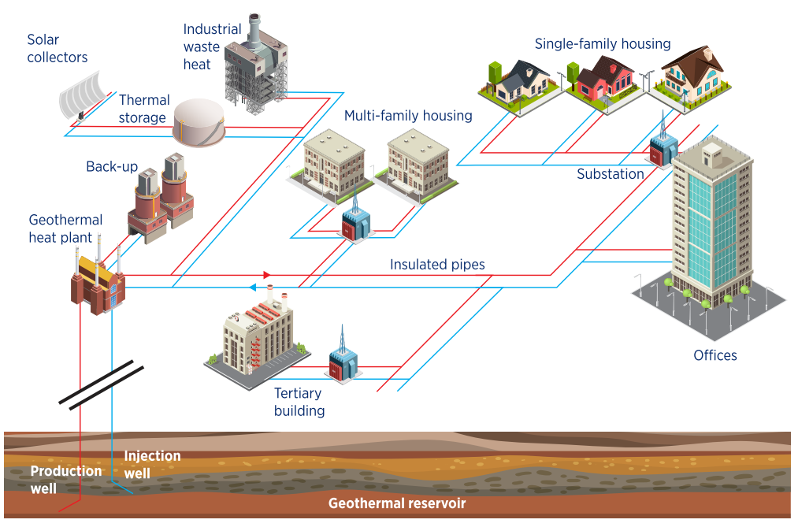
IRENA. Integrating low-temperature renewables in district energy systems: Guidelines for policy makers. IRENA; 2021.

Slide 18
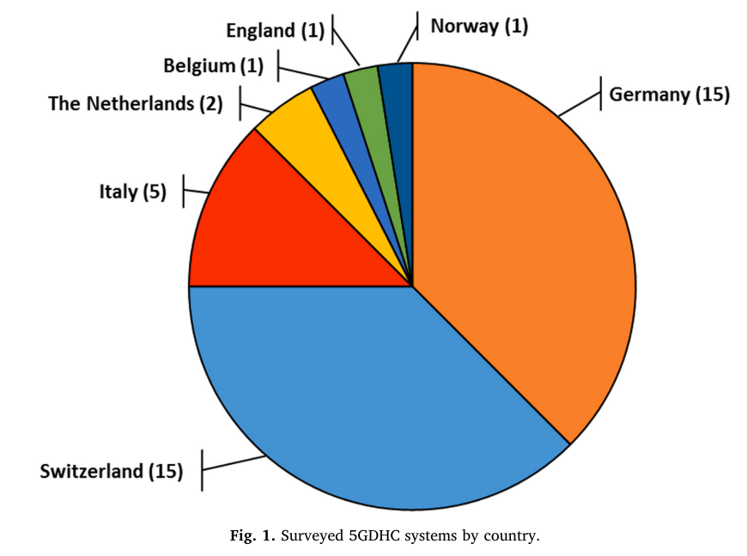
District heating and cooling systems (5th Generation, Anergienetze)
23
Buffa S, Cozzini M, D’Antoni M, Baratieri M and Fedrizzi R 2019 5th generation district heating and cooling systems: A review of existing cases in Europe Renew. Sustain. Energy Rev. 104 504–22
Notes:
A 5GDHC network is a thermal energy supply grid that uses water or brine as a carrier medium and hybrid substations with Water Source Heat Pumps (WSHP). It operates at temperatures so close to the ground that it is not suitable for direct heating purpose. The low tem- perature of the carrier medium gives the opportunity to exploit directly industrial and urban excess heat and the use of renewable heat sources at low thermal exergy content. The possibility to reverse the operation of the customer substations permits to cover simultaneously and with the same pipelines both the heating and cooling demands of different buildings. Through hybrid substations, 5GDHC technology enhances sector coupling of thermal, electrical and gas grids in a decentralised smart energy system.

Slide 20
Classical
Bidirectional
Reservoir
Supply pipe
Warm pipe
S
S
BP
S
Reservoir loop
Return
pipe
Cold
pipe
Pr
Pr
Pr
Pr
Pr
Pr
Pr
Pr
Pr
Pl
Pl
S
S
Pl
S
Notes:
Fig. 7

Slide 21
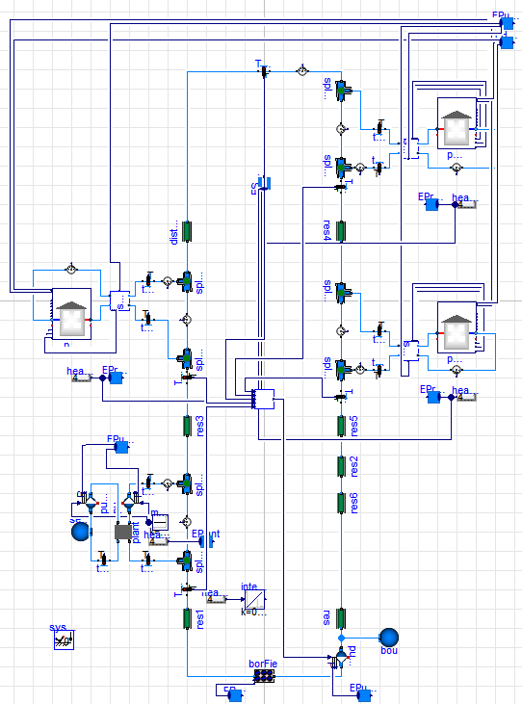
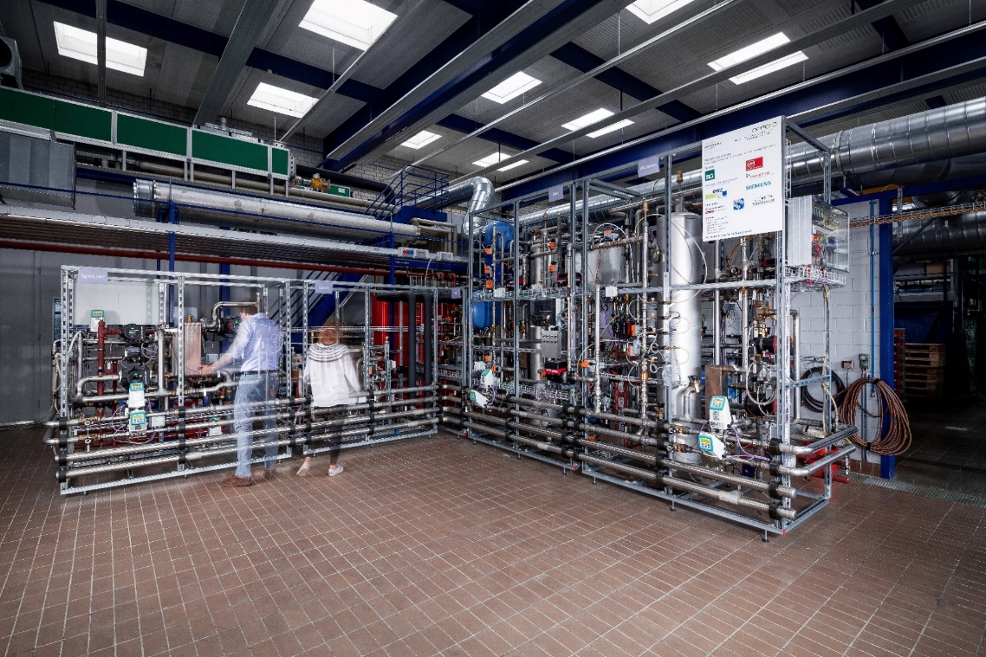
Simulations
(Reservoir)
NODES – Lab
(Classical, Bidirectional)
Foto: Reto Häfliger

Slide 22
[1] Sommer T, Mennel S, Sulzer M. Lowering the pressure in district heating and cooling networks by alternating the connection of the expansion vessel. Energy 2019;172:991–6. https://doi.org/10.1016/j.energy.2019.02.010.
[2] Sommer T, Sotnikov A, Sandmeier E, Stettler C, Mennel S, Sulzer M. Optimization of low-temperature networks by new hydraulic concepts. J Phys Conf Ser 2019:1343. https://doi.org/10.1088/1742-6596/1343/1/012112.
[3] Sommer T, Sulzer M, Wetter M, Sotnikov A, Mennel S, Stettler C. The reservoir network: A new network topology for district heating and cooling. Energy 2020;199:117418. https://doi.org/10.1016/j.energy.2020.117418.
[4] Sotnikov A, Sandmeier E, Sulzer M, Sergi T, Mennel S, Sommer T. Thermal stability and heat transfer in the reservoir low-temperature network. J. Phys. Conf. Ser., vol. 1343, 2019. https://doi.org/10.1088/1742-6596/1343/1/012113.
[5] Stettler C, Schluck T, Sulzer M, Sommer T. Electricity consumption of heat pumps in thermal networks depends on network topology. Build Simul Rome 2019 2019:1–8.
[6] Sommer T, Sotnikov A, Sulzer M, Scholz V, Mischler S, Kristian G, et al. Hydrothermal challenges in low-temperature networks with distributed heat pumps. submitted to Energy; 2021.

Slide 23
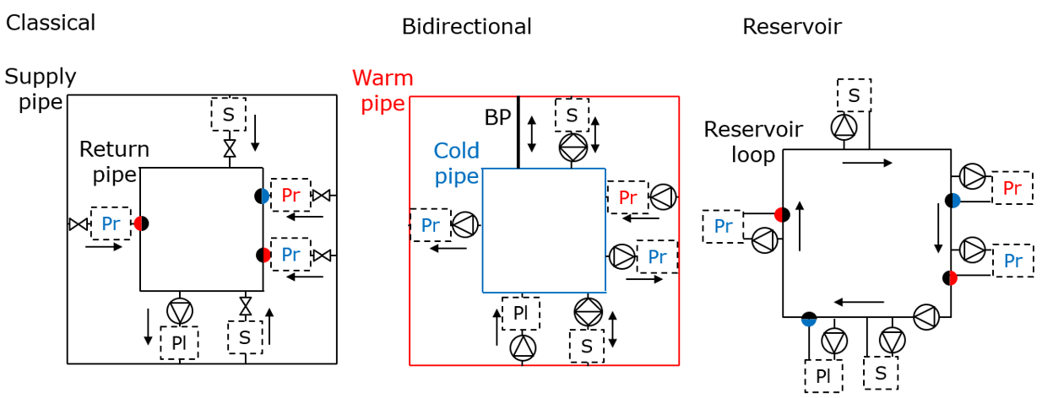
Lake water networks
Thermally most efficient
Hydraulics challenging
Hydraulics simple
Temperatures challenging
Pipe savings for circular network layout

Slide 24
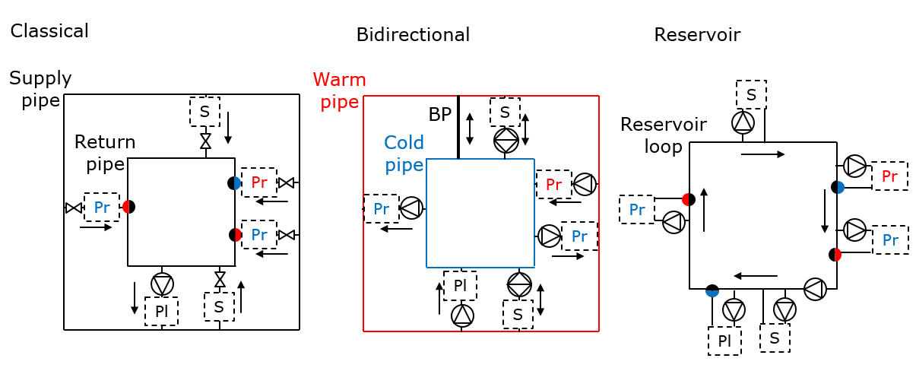
District heating can reduce to total CO2 emissions in Switzerland by approximately 5 %.
Build more networks
Factor of 2 to 3 increase in district heating realistic for Switzerland
Temperature reduction

Slide 25
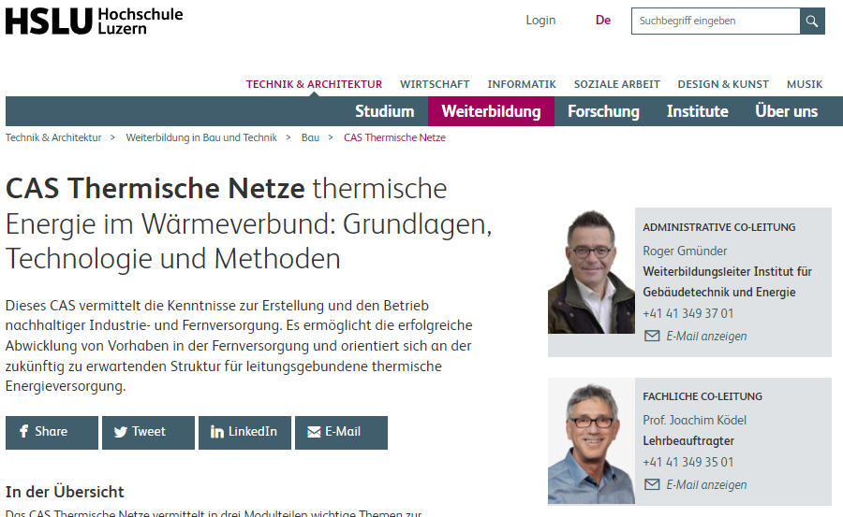
https://www.hslu.ch/de-ch/technik-architektur/weiterbildung/bau/cas-thermische-netze/
https://www.sweet-decarb.ch/publications/further-education#c335
Notes:
Training, materials science, high temperature networks, thermodynamics, economy, chemistry, planning, admin, politics, system decision, non-technical topics, optimization

Slide 26
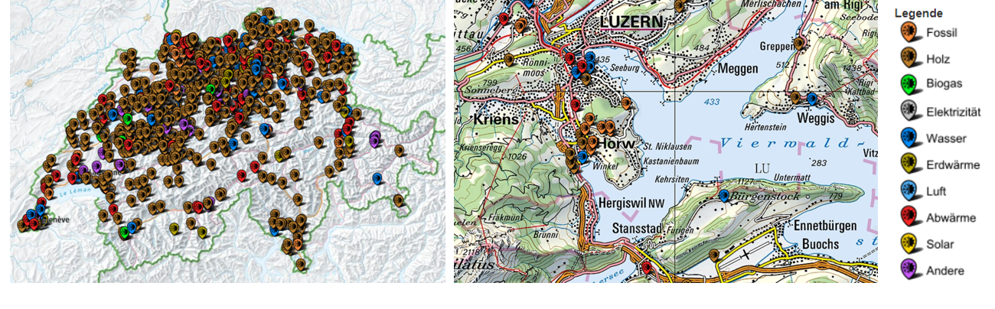
Existing thermal networks in Switzerland (2020).
Source: https://map.geo.admin.ch/, Layer «Thermische Netze»), Credit Diego Hangartner, Joachim Ködel, Programm Thermische Netze, SFOE
Notes:
a, Übersicht aller thermischen Netze. b, Kartenausschnitt aus der Gegend Luzern/Vierwaldstättersee. Das blaue Symbol weisst in diesem Ausschnitt auf Seewassernutzung hin. (

