Slide 1

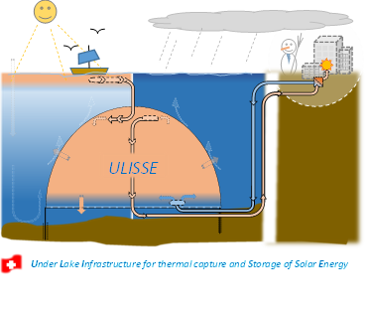

SOUR Call 1-2021 ULISSE Project
Under Lake Infrastructure for thermal capture and Storage of Solar Energy
Host Institution
William van Sprolant
CvS énergies sàrl
Date: 28.11.2023

Slide 2
ULISSE Project
Under Lake Infrastructure for thermal capture and Storage of Solar Energy
Author: William van Sprolant, CvS énergies sàrl, cvs-energies@mecacerf.ch
Contributions of the host institution: HEPIA (alphabetical order):
Alain Dubois, Reto Camponovo, Daniel Bello Mendes, Jean-François Rubin, Peter Gallinelli, Jeremy Olivier, Roland Rozsnyo, Gilles Trisconne, Zsolt Vecsernyes https://www.hesge.ch/hepia/annuaire
Project start – end: 09.2021 – 05.2023
SFOE project coordination:
Laura Ding, laura.ding@bfe.admin.ch
SFOE contract number: SI/502277-01
The author bears the entire responsibility for the content of this report and for the conclusions drawn therefrom.

Slide 3
Plan of the presentation
Context: major challenge of the Swiss Energy Strategy - 2050
Development and limits of Thermal Lacustrine Networks (TLNs)
Dual purpose of the ULISSE project
Potential lake impacts of ULISSE
Origin of the project and state of the art
Seasonal heat storage efficiency
ULISSE application example on the TLN GeniLac and on Geneva’s public Drinking Water Network (DWN)
National potential and alternative solutions
Next step
Collaborations and Financing
Conclusion

Slide 4
Major challenge of the Swiss Energy Strategy 2050
Development of gross electricity production during the winter and summer months in the ZERO-baseline scenario, strategic variant in 2050, in TWh (source: SFOE EP2020+)
Faced with climate change, the Swiss Energy Strategy 2050 (SES-2050) aims for a “double neutrality": Nuclear & Carbon" (2035-2050) and foresees a structural deficit in the winter semester of 9 TWh electricity.
It results from the planned withdrawal of nuclear electricity in 2035 and the increase in electricity demand for: Electric Mobility, Air Conditioning, Heat Pumps for building heating and domestic hot water production, as well as for the decarbonisation of industry.
The major challenge of the SES-2050 is to have enough “doubly neutral" electricity in winter !

Slide 5
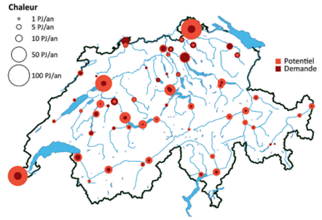
Development & limits of Thermal Lacustrine Networks
The SES 2050 provides for the massive development of urban Thermal Networks, supplied with renewable energies and waste heat, for air conditioning, cooling and heating needs.
1/4 to 1/3 of the Swiss population is located near the 15 largest Swiss lakes and could potentially be connected to a Thermal Lacustrine Network (TLN).
TLNs are very effective for summer air conditioning by "free cooling" (without heat pumps, COP => 18).
The heating of buildings needs heat pumps in winter is 4 to 5 times less efficient (COP ≈ 3) who contributes to increases the winter electricity consumption of TLNs.
Winter semester
(135 PJ local heat requirement)
COP summer free cooling = 18
COP winter heating = 3
Thermal Lacustrine Network (TLN)
with MorgesLac in the town of Morges (VD)
Source: Thermal use of surface waters A. Gaudard; M. Schmid,
Eawag; A. Wüest, Eawag and EPFL, AQUA & GAS Nº 6

Slide 6
Not only glaciers are threatened by Global Warming !
The surface temperature of our lakes has increased by about 2˚C over the past 40 years.
Global Warming results in less cold winters, REDUCING THE MIXING OF LAKE WATER AND THE OXYGENATION OF LAKE BOTTOMS (hypolimnion), which is essential for aquatic life. This lake asphyxia induces the release of phosphorus from sediments, and the viscous circle of the eutrophication (production of, toxic blue-green algae blooms, CO₂, CH_{4,} H₂S and consuming also the oxygen).
Despite thermal potential of lakes exceeds local needs by several times, in order not to further impact the aquatic ecosystem, lake thermal use is limited and regulated (ordinance).
One of the challenges of Switzerland's 2050 Energy Strategy is therefore to develop the thermal-lake potential, while PROTECTING our lakes against the harmful effects of Global Warming !

Slide 7
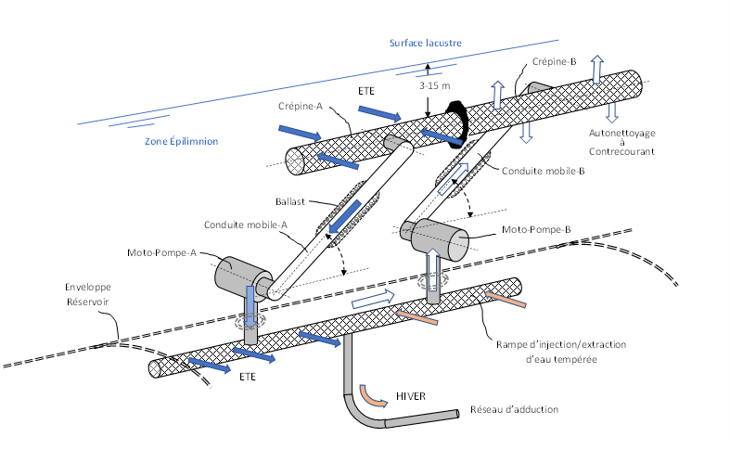
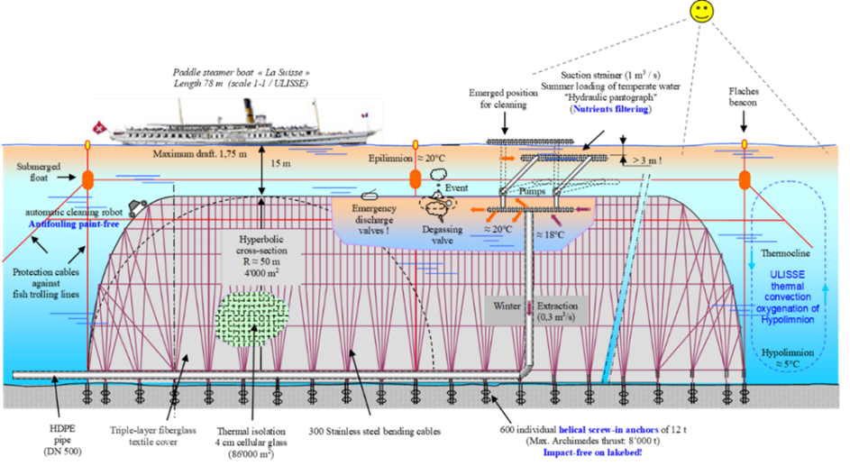
ULISSE project with a dual purpose
1) Thermal Lacustrine Network booster by under-lake reservoirs :
Providing a winter lake heat source of around 20°C, instead of the usual 5-6°C
Double the efficiency of heat pumps (HP) and reduce by 95% the energy for pumping and circulating water in the Thermal Lacustrine Networks (TLNs).
Hydrothermal pantographe
Annual cycle:
1. 2 moths Summer Loading (SL)
2. 2 moths Autumn Stagnation (AS)
3. 6 moths Winter Discharging (WD)
4. 2 moths Spring Stagnation (SS)
External convection currents induced by heat loss, produces oxygenation of the lake, protecting it against Global Warming !

Slide 8
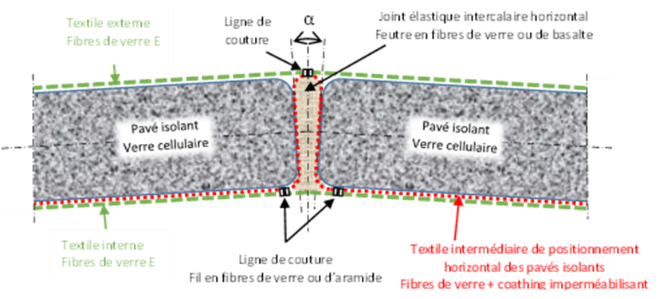
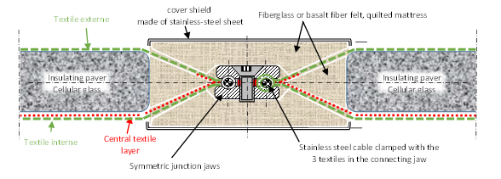
Constructive details of the ULISSE Reservoir
Envelope
Cross section of the ULISSE type tank casing (junction of the insulating blocks)
Anchoring
Principle of anchoring the ULISSE Reservoir on the lake bottom
with Marine Flex helical screw anchors
Junction of the transverse strips of the envelope of the ULISSE Reservoir

Slide 9
Potential Environnemental lake impacts of ULISSE Reservoirs
External convection currents, induced by heat loss through the biocompatible envelope (textile and cellular glass) of ULISSE reservoirs, can improve the circulation of nutrients and the oxygenation of the lake bottom, protecting the aquatic ecosystem against Eutrophication and Global Warming !
The presence of the ULISSE Reservoirs can create, around (vicinity), ecological niches protected from fishing and thus promote the development of aquatic fauna.
Selective capture (filtration of phytoplankton) would make it possible to regulate “blooms” (toxic algal blooms), if necessary, to recover GHGs and CH₄ (for energy use).
The confinement of the heat captured in the reservoirs would lowering the surface temperature of the lake, the loss of water by evaporation and would further increase the dissolved oxygen in the water.

Slide 10
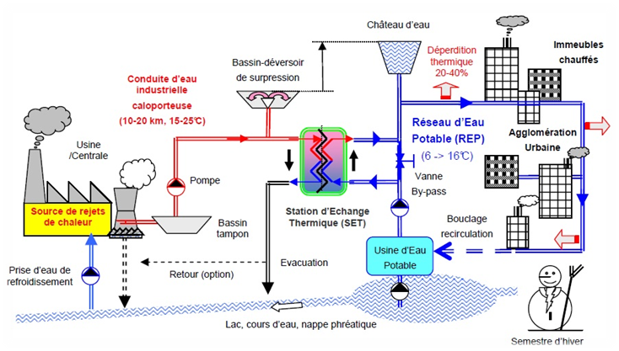
2) CORSAIRE “free heating” (without heat pump)
“The public drinking water network is a thermal network that is ignored “
The second way of using the temperate water provided by the ULISSE Reservoirs or other thermal discharges is correcting the winter drop in temperature (5 to 10˚C) of the public drinking water networks (DWN) by the CORSAIRE “free heating” (without heat pump).
All DWNs are potentially affected by "free heating" which can provide 30% of the heat for domestic hot water production (DHW), reduce the electricity consumption of connected washing machines/dishwashers and increase the general electrical efficiency of TLNs.
The CORSAIRE free heating can potentially reduce the heat demand index (HDI for room heating and DHW) of residential buildings on the scale of a city by up to 10% (current state of their energy efficiency) without any intervention or additional equipment on the buildings!

Slide 11
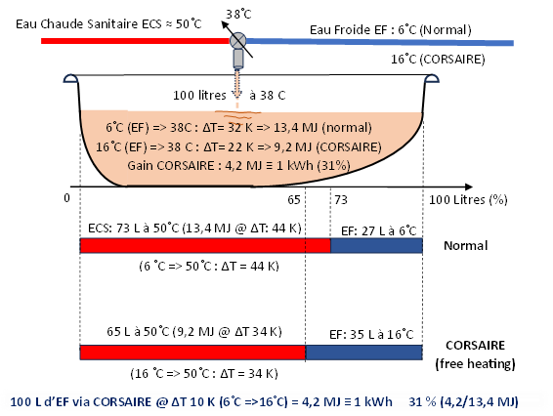
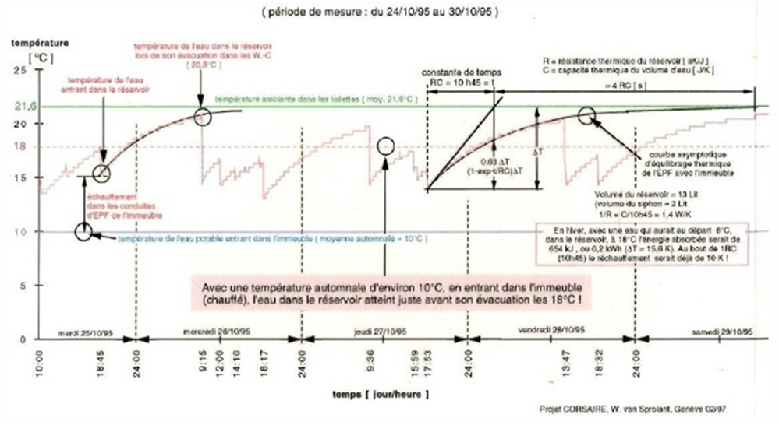
CORSAIRE free heating impacts
(influences of the cold water temperature)
Domestic Hot Water production (DHW)
1/3 Reduction of the heat for DHW production
Free heating of the public DWN reduces parasitic heating of toilet water witch causes undesirable cooling of the building.
Cold water in toilets (WC) average increase of 8˚C at the beginning of the heating semester. (≈ 1/3 of household drinking water consumption !)

Slide 12
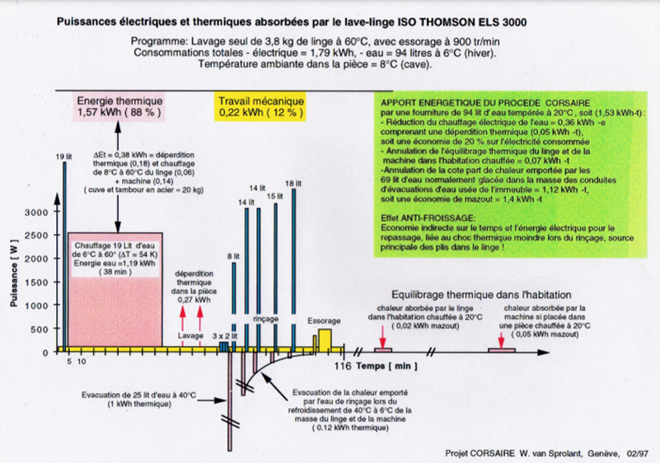
Impact of the cold-water temperature for washing machines and his free heating (∆Tcor: 10 K)
The same concerns the dishwashers !
(Main reason why “water-machines” must be connected also to the DHW)
Water heating represent 70 - 80%
of the electricity consumption of a
standard washing machine (ADEME).
Medium water temperature
of a washing cycle : 40˚C
∆Tw: 34 K (40 - 6˚C, electrical heating)
∆Tcor: 10 K (16 - 6 ˚C, free heating)
Free heating gain: 10 K/34 K = 29,4%

Slide 13
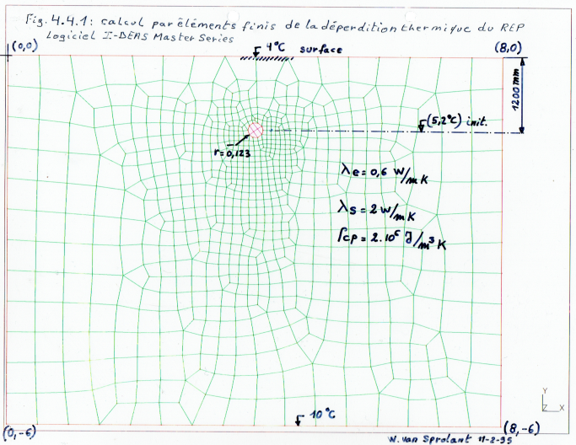
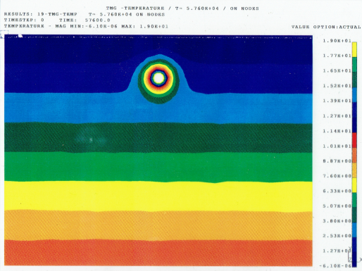

Heat flux simulation from the public Drinking Water Network during “winter de-icing” (CORSAIRE free heating)
Example of Geneva’s DWN (1995*) : ≈1’200 km (≈50/50 meshed/branched network)
Total capacity ≈ 56’500 m³ ; Pipe surface : 728’000 m² => Medium diameter : 193 mm (≈ DN 200)
Daily winter water supply: 175’000 m³/d
I-DEAS Master-Series
Medium pipe diameter : 193 mm
(728’000 m² / π*1200 km)

Slide 14
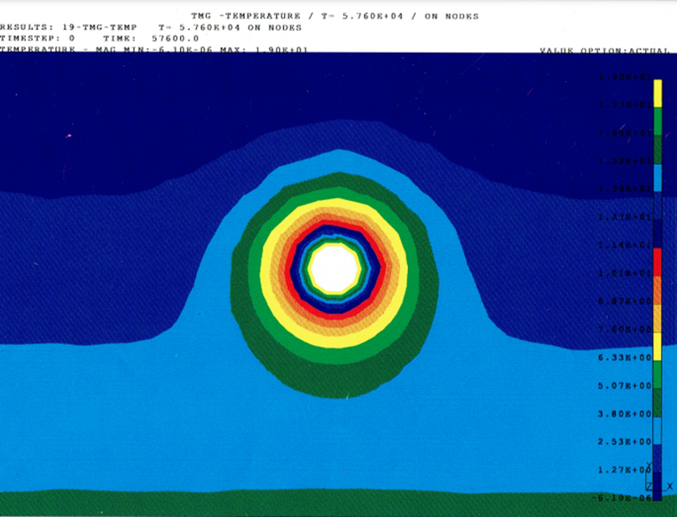
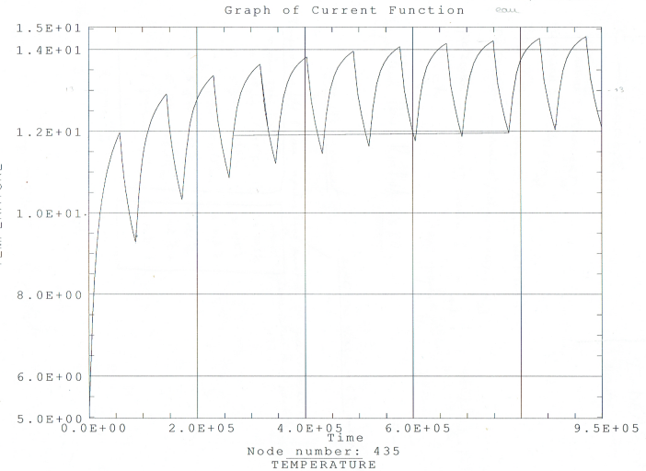

Temperature evolution in the soil around the pipe at 25 cm (R2) from the center by free heating
Circular linear conductivity of the soil layer (R1-R2) around the pipe Ks: 13 W/K
16h Diurnal Water Flow (175’000 m³/d)
To ≈ 19˚C , ∆To-Ts ≈ 15 K
14˚C
12˚C
Day 7: ≈12˚C
Day11: >12˚C
8h Nocturnal Water Stagnation
(temperature drop)
Day 1: 9,2˚C
Asymptotic evolution of the
Soil layer temperature at R2 (↗)
=> ∆T_{r1-r2} & Linear Heat loss Q⁻ slow down
Q⁻ = Ks * ∆T_{r1-r2} [W/m]
Medium pipe
diameter : 19,3 cm
R1 : 9,5 cm
Day 0: 5,5˚C
R2: 25 cm
(*) : master thesis EPFL 1995 W. v. S.

Slide 15
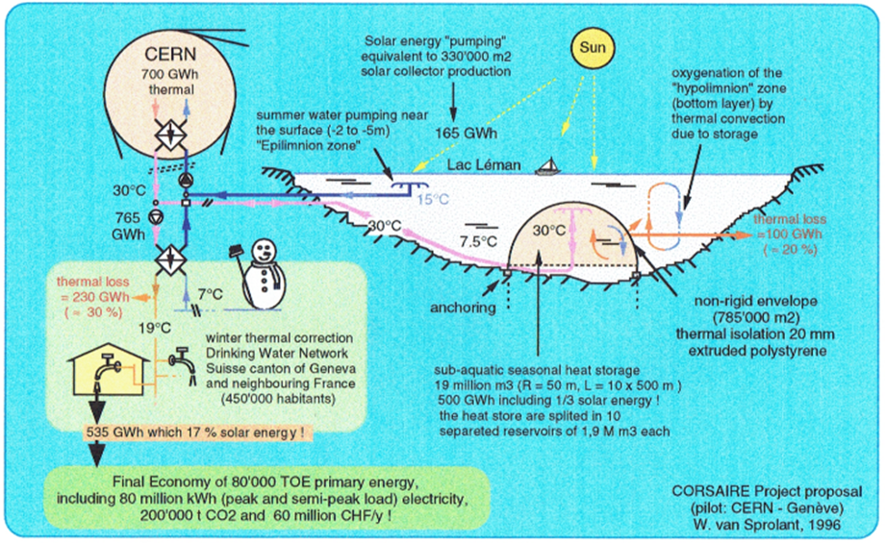
Origin of the CORSAIRE and ULISSE projects & state of the art
1992, “Prehistory”: personal proposal of the VERCAD project for “Great Geneva” region (first medium at low temperature district heating network supplied by industrial waste heat from CERN, Cheneviers waste incineration plant, etc.).
1995, personal master thesis at EPFL : Waste heat recovery from CERN in the winter temperature correction of the drinking water network (DWN) of Geneva (CORSAIRE process).
1996, proposal of a Seasonal Lacustrine Heat Storage to recover the heat of the cooling water from CERN during the summer semester to valorise it in winter semester (when CERN is in shut down). Poster session on the 10th general conference of the European physical society (EPS), Seville, Spain, September 1996.
2005, the CORSAIRE project is included in the Energy Master Plan of the canton of Geneva (2001-2005). November 2005, start of part -1 of the multidisciplinary impact study on a pilot residential building made available by the city of Geneva; 3 months later, abruptly stopped on the grounds of an unforeseen budgetary restriction of the OCEN…

Slide 16
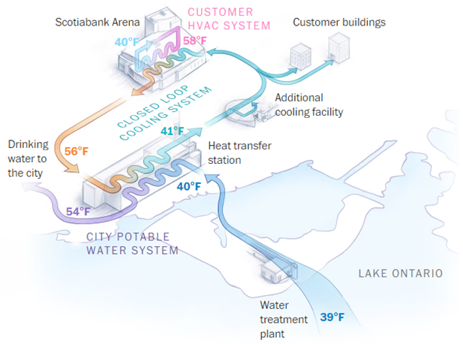
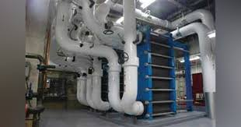

2006, CORSAIRE principle has been used (in summer !) in the Canadian city of Toronto (3 million inhabitants, 1/3 of Switzerland) with its “Deep Lake Water Cooling” (DLWC) network! With a cooling capacity of 360 MW, the thermal energy extracted from the air conditioning is injected into Toronto's public Drinking Water Network via a heat exchangers (CORSAIRE process in summer) !
Heat exchanger on Toronto’s urban Drinking Water Network
=> CORSAIRE “free heating” (1995) since summer 2006 !
Source: ENWAVE
2021-2023, proposal of the ULISSE project for the SOUR Call 1-2021…

Slide 17
The ULISSE & CORSAIRE system on TLN GeniLac & Geneva’s DWN
350 buildings connected in 2045
245 GWh-thermal
Summer « free cooling »
COPsys : 18
250 GWh-thermal
Winter Room Heating
& Domestic Hot Water
COPsys : 3,4 – (3,2 @ 2050)
+ 27 GWh-th
Natural gaz (backup)
Vengeron main pumping station, Nominal flow 10 m³/s
T_{lake}≈ 6/3˚C, ∆T_{lake} : 3 K => 125 MW-t (Nominal Thermal Power)

Slide 18
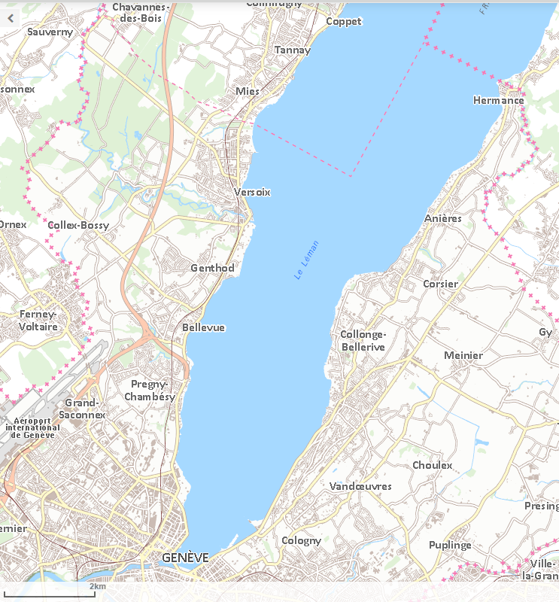
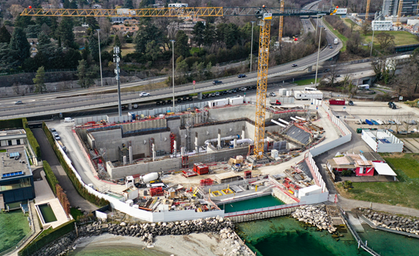
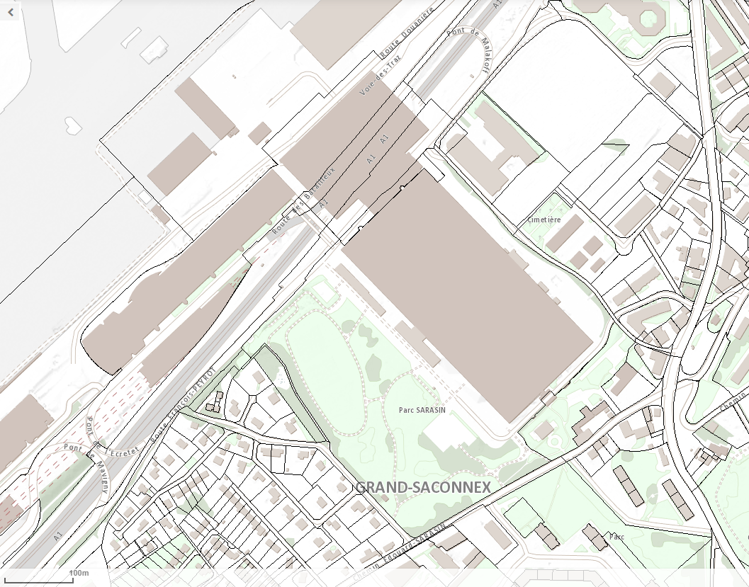
ULISSE for GeniLac
6 Reservoirs of 2 M m³ = 12 M m³ @ ∆T 15 K :
0,72 PJ = 200 GWh => 17’000 toe
Main pump station
“Vengeron”
Economies: 37 GWh-e + 72’000 t CO₂
≈ 11 + 4 = 15 millions CHF/y (*)
Conduite
isolée
ULISSE
( 6 km, 0,7 m³/s)
Reservoir ULISSE
100 x 550 m, 2 M m³
(125 TJ or 35 GWh-t)
Crépine
GeniLac
(- 45 m
10 m³/s)
StaP
GeniLac
Scale ratio
Crépines
GLN &
EP Prieuré
(- 35 m)
PALEXPO
StEP
Prieuré
(*) : prix spot 300 €/MWh ; 50 €/tCO₂
StP
Arquebuse

Slide 19
Assumptions of the climate state and energy efficiency of buildings in 2050 (ECEEB)
20% increase of the need for cooling (air conditioning), 20% reduction of room heating, + 20% Improving the building's energy production efficiency.
Generalized connection of washing machines and dishwashers to Domestic Hot Water (DHW), increase the specific DHW demand by an additional 20% (suppression of the water heating by Joule effect).
40% reducing of the Heat Demand Index specific to room heating (HDI-rh), expressed in MJ/m² ERS (Energy Reference Surface) => the "Mix-rh/dhw" goes from 70/30% (actual) to 55/45% (2050) => decrease by 22% the room energy density (MJ/m²) of TLN’s (such as GeniLac), due to the concomitant increase in DHW demand of 20%.
To maintain the overall supply of useful heat (Qu+: 250 GWh-t for GeniLac), the TLN’s will have to extend spatially in order to cover a larger urban territory (≈ 30%).
Extension of the network increases the hydraulic head losses in proportion and will result in an increase in the electrical energy of the circulation pumps.

Slide 20

Performance (COP) of the Heat Pumps & Circulation Pumps, depending on lake-water and end-uses temperatures (Heating + Domestic Hot Water)
Example of WATER/WATER Type Heat Pump TRANE RTSF 110 (source: SIG)
The COP includes the water circulation pumps through the condenser and evaporator heat exchangers, but not the Main Pumping Station of the Vengeron !

Slide 21
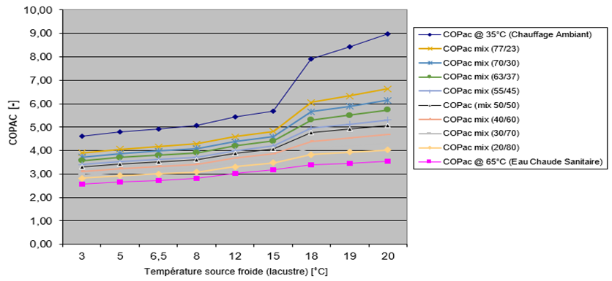
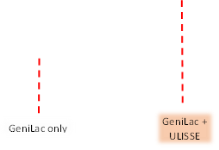
Extrapolation of the COP performance of the heat pumps in function of the excursion of the lake water temperature by ULISSE
Lake Léman upper layer
25˚C August 2023 !
(How much in 2050 ?)
21
22
23
24
25˚C

Slide 22
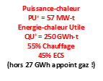

Water and Energy flows for GeniLac heat pumps in winter (ECEEB-Actual)
(ULISSE only, without CORSAIRE free heating)
Reduction of the efficiency (COP) due to 30% first network extension in 2050 necessary for the supplying of the same amount of energy
(modification of the ratio or mix-space heating/DHW)

Slide 23
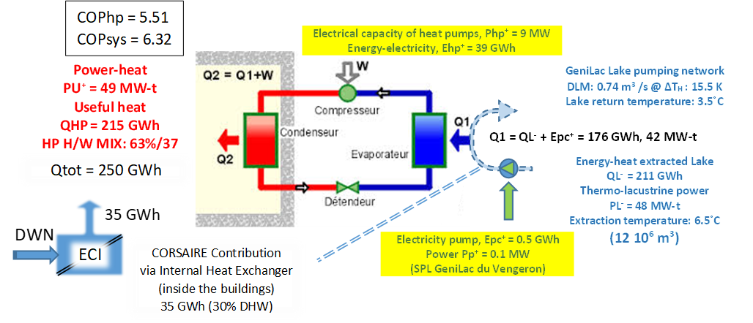
Impact on the performance of the TLN of the cold-water CORSAIRE “free heating” heat exchanger inside the building (internal (no public DWN free heating)

Slide 24



Combination of the TLN GeniLac network in the winter semester with ULISSE & CORSAIRE-Public-DWN (ECEEB-2050)
In 2050, ULISSE & CORSAIRE free heating can potentially reduce the Winter electricity consumption of the TLN networks such as GeniLac by more than half :
COPsys: 3,18 => 6,32
« Vengeron »
pumping station

Slide 25
Energy evolution of cold (Froid) by free-cooling and heat (Chaud) by heat-pumps, associated with the lake water volume (M m³), the electricity (GWh) for hydraulic- and heat-pumps applied at GeniLac alone and with ULISSE and CORSAIRE

Slide 26
Evolution of the energy (GWh) for cold (Froid) and heat (Chaud), lake water (M m³) and COPsys, applied to GeniLac – alone and with ULISSE + CORSAIRE

Slide 27
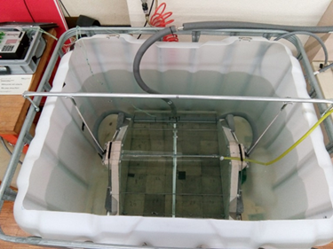
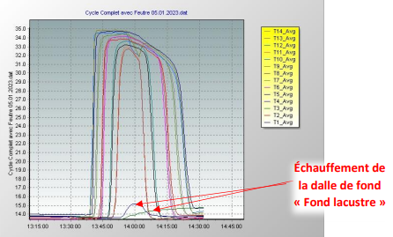
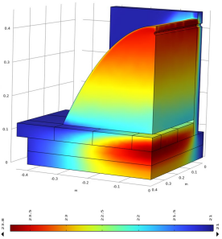
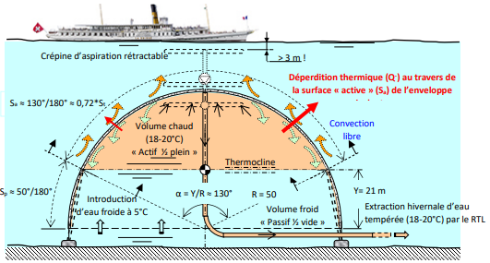
Storage efficiency of the ULISSE Reservoir and the Mock-up
1) Physical Mock-up
3) Numerical simulation of the Mock-up
Physical reproduction of a
full cycle Mock-up
2) Theoretical model
of the UISSE Reservoir

Slide 28
The net storage efficiency (NSE), for the ULISSSE full-size reservoir and the Mock-up, is between 74,80% (N30) and 89,06% (N37), with an average of 83% (N26-N38)
The latest results of the numerical
simulation (COMSOL Multiphysics) of the Mock-up show a net storage efficiency of 82%.

Slide 29
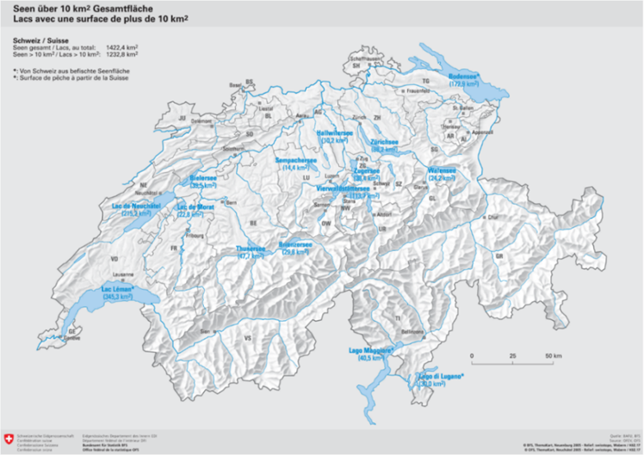
National potential of ULISSE and CORSAIRE “internally” (via the TLN)
2050 (ECEEB) assuming widespread use of ambient heating and DHW production via TLN networks in the "urban agglomerations of the 15 greatest lakes", (1/4 of the Swiss population: Qc = 50 PJ/year of heat for a total of 200 PJ), the winter electrical energy (Esys) to supply the heat pumps (HP) and the lake pumps (LP) would be 15,3 PJ (6,4 TWh, with COPsys = 3,26).
The association of these TLN networks with ULISSE and CORSAIRE (Internal/External) would allow a gain of 50% by a COPbat = 6,34, i.e., a net winter electrical energy saving of 2,07 TWh (∆Esys):
∆Esys = (Qc / COPbat) – (Qc / COPsys) = (50 PJ/6,34) – (50 PJ/3.26) = 7,45 [PJ] or 2,07 [TWh]

Slide 30
Distribution of 310 ULISSE Reservoirs of 2 M m³/unite in the15 largest Swiss lakes in proportion to the surfaces
(what about a distribution according to the local population ?)
Total ULISSE volume = 620 M m³ = 1,5 x Grande Dixcence water storage volume (400 M m³) but save potentially equivalent as twice his winter semester electricity production !

Slide 31
National CORSAIRE potential @ 2050 via the public DWN “externally” (excluding TLNs or lake regions)
During the winter semester, the CORSAIRE free heating of the the DWN can exploit the residual heat of wastewater treatment plants (WTP). Without seasonal heat storage it can be freed of the lakes regions and be accessible to all urban agglomerations of sufficient density.
With the conservative assumption that in 2050: only half (P1=0,5) of the buildings are connected to a public DWN free heating system (excluding TLNs: P2 = 0,25), resulting in 6,75 PJ (*) of heat supplied for DHW avoids 0,69 TWh electricity.
(*): 6,75 PJ : 200 PJ x (P1-P2) x P3 x P4 = 200 PJ x 0,25 x 0,45 x 0,3 = 6,75 PJ
6,75 PJ, without free heating, would by supplied by heat pumps with a COP of 2,73 => 0,69 TWh-e
200 PJ : National heat demand for Room Heating & DHW production; P3 @ 2050 : RH/DHW = 0,45
P5 @ 2050 = 0,3 part of DHW by free heating

Slide 32
National potential electricity and investment savings by ULISSE & CORSAIRE @ 2050
The ULISSE and CORSAIRE ensemble, by providing 57 PJ of heat (nearly 30% of national needs), potentially constitutes a net Winter Electricity Saving (WES) of 2,76 TWh :
  WES = ∆esys + ∆edhw = 2,07 TWh (TLNs) + 0,69 TWh (DWN) = 2,76 [TWh]
Taking into account the transformation and transport of the electricity losses in winter, of 10% (7% on annual average), the net 2,76 TWh require a gross production of 3 TWh or 1/3 of the structural winter electricity deficit in 2050 (9 TWh), equivalent of the gross winter production of two hydropower complexes as Grande Dixence in 2050.

Slide 33
Financial costs and savings of ULISSE & CORSAIRE @ 2050

Slide 34
Alternatives of ULISSE
Total footprint: 144’000 m² (land) for solar thermal collection infrastructure
(70’000 m² of flat collectors) and the seasonal storage basin (210’000 m³ with its floating cover)
of the urban agglomeration of Vosjens fjernvarme (DK) and comparison with a ULISSE Reservoir.

Slide 35
Investment cost of different types of hot water storage (source: HSLU hochschule luzern).
We observe the effect of size (economy of scale) with a linear regression which tends towards 10 CHF/m³ @1 M m³
1ULISSE Reservoir
+/- 20 M CHF (?)

Slide 36
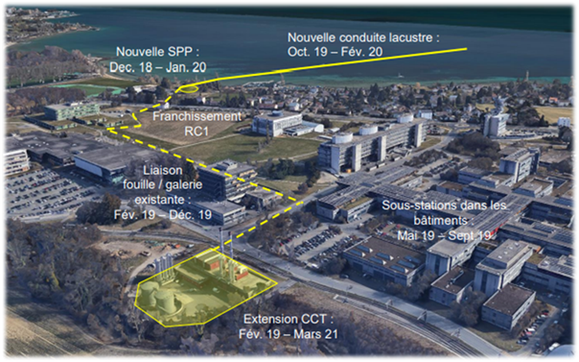

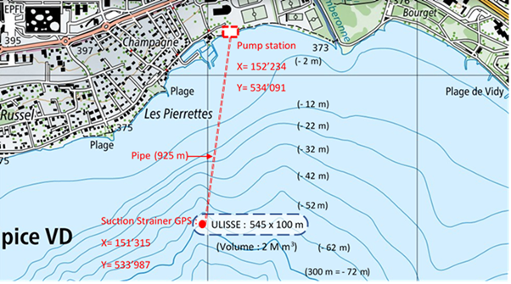
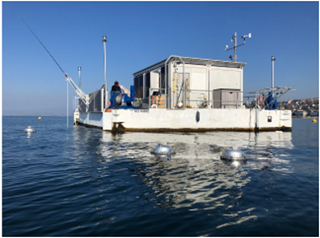
Next step of the dual ULISSE & CORSAIRE P+D projects
A. For the ULISSE part:
1. Continue the numerical simulation (COMSOL) of the Mock-up and of the full-scale ULISSE Reservoir.
2. Analyse the real potential for the installation of ULISSE Reservoirs (2 M m³) in the 15 largest Swiss lakes.
3. Carry out an in-depth environmental impact study for the lakes concerned.
4. Realization of an in-depth study of the hydrodynamic behaviour of the ULISSE Reservoirs against the lake currentology; particularly the structural integrity of the Reservoirs against internal “seiches” causing internal opposing shear currents in the large lakes (appendix: 3).
5. Development of an autonomous drone for cleaning the envelope and inspecting the standard reservoir.
6. Development of a 1st prototype of the intermediate-sized reservoir for a first study of the behaviour in a closed basin or a lake.
7. Realization and installation in real situation of a pilot test of a full size (2 M m³) with observation (LéXPLORE) of the physical and environmental behaviour against the lake. The connection to the CCT would make it possible to test the energy impact of ULISSE on the performance of brand new heat pumps and lake water pumping station (SPP) of the EPFL – UNIL campuses.
LéXPLORE platform

Slide 37
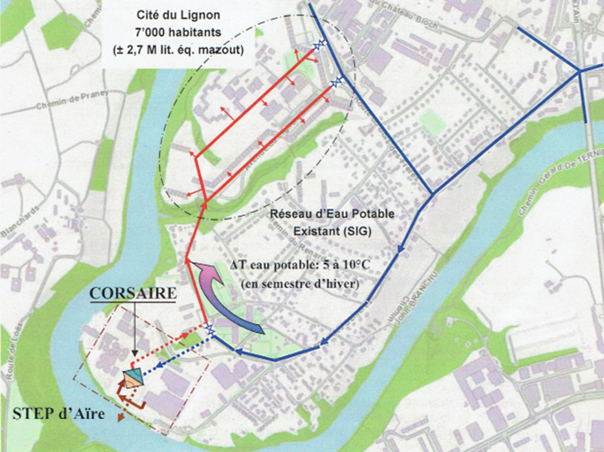
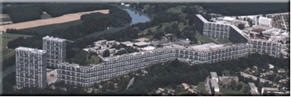
B. For the CORSAIRE free heating part:
The ULISSE project, associated with the integration of the CORSAIRE free heating process, should restart the CORSAIRE project officially included and initiated in cantonal energy master plan 2001-2005 of Geneva.
The Services Industriels de Genève (SIG) are in charge of the public drinking water network (DWN) of the canton of Geneva and fully involved in the GeniLac project, “flagship” of the TLN in Switzerland. For this, the following points should be taken up:
1. Basic study (master thesis of W. van Sprolant EPFL 1995).
2. Study of the specific heat loss of the public drinking water network (DWN).
3. Study of the physical integrity of the DWN (under winter free heating).
4. Study of the sanitary integrity of the tap water undergoing a winter temperature correction.
5. Psychosociological study of the acceptance of the winter modification of the tap water temperature
6. Study of the impact(s) of the CORSAIRE free heating on a pilot building Cité du Lignon
Proposal for the Cité du Lignon in Geneva temporary connected to the Aïre Waste Water Treatment Plant as a Pilot for a multidisciplinary impacts study of the CORSAIRE free heating on the public Drinking Water Network
The Cité du Lignon
2’780 housing units, 6’500 inhabitants

Slide 38
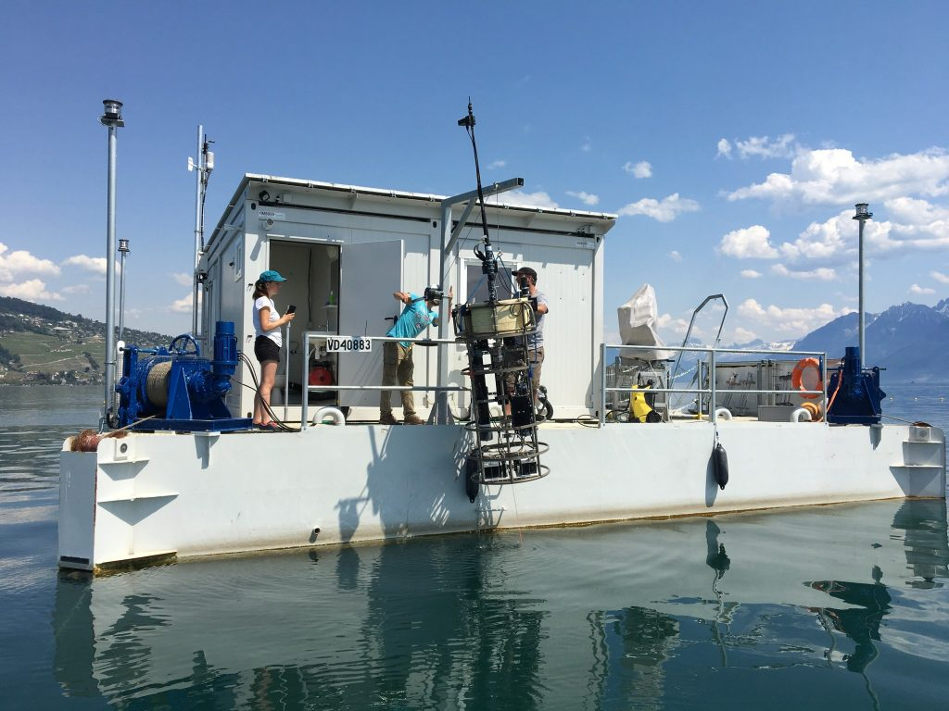
Potential Collaborations
- DeCarbCH SWEET Consortium (Decarbonisation of heating and cooling in Switzerland): Thermal grids (cooling & heating), heat pumps, renewable seasonal heat storage, partnership between: UNIG, ETH Zurich, HSLU, HEIG^{VD}, OST, ZHAW, SUPSI, INDP, CREM, EMPA; (2021 – 2028)
- SIG, SI of other cantons
- EPFL (ULISSE Reservoir engineering and tests, COPsys measurements on CCT, etc.)
- LéXPLORE: (partnership between EPFL, Eawag, UNIG, UNIL,
and CARRTEL in Thonon-les-Bains).
- Federal and Cantonal Energy Offices
- CERN…
The LéXPLORE platform for lake research on Lake Geneva,
currently anchored opposite the port of Pully (VD)

Slide 39
Financing of the ULISSE & CORSAIRE
Pilots + Demonstration Projects
- The budget for the two Pilot & Demonstration projects are still to be established.
- The cost of 20 M CHF for a 2 M m³ ULISSE Reservoir prototype (10 CHF/m³) is only a
Simple linear extrapolation with existing thermal storage systems (Figure: HSLU Hochschule Luzern).
- Amendment and entry into force on January 1, 2024 of the Federal Energy Act (LCI):
Art. 53, financial aid can amount to 70% for installations and pilot projects presenting an early stage of technological maturity and a high financial risk (=> ULISSE) !

Slide 40
Conclusion
The Swiss Energy Strategy (SES-2050) forecasts a structural deficit in the winter semester of 9 TWh electricity (≡ national hydropower storage capacity).
ULISSE could boost the hydrothermal potential of the greatest Swiss lakes while protecting them against Global Warming. In winter semester the energy efficiency of the heat pumps increases by 50 % and the water pumping energy of the Thermo Lacustrine Networks (TLNs) reduces by 95%.
CORSAIRE free heating could reduce the negative energy impact of the winter drop in the temperature of the public Drinking Water Networks (DWN) and could provide 30% of the heat for Domestic Hot Water (DHW), witch increase again the electrical efficiency of TLNs and reduce also by 30% the electricity consumption of washing machines/dishwashers connected to the DHW,
Approximately 300 ULISSE reservoirs distributed invisibly in the 15 largest Swiss lakes and in association with CORSAIRE free heating (including outside lake regions), could provide nearly 60 PJ or 30% of the 200 PJ of national energy needs for room heating and DHW production. This would save 3 TWh of gross electricity in the winter semester (1/3 of the 9 TWh of winter electricity deficit in 2050).
Despite the urgency, it seems likely that the objective of carbon neutrality will not be achieved in 2050. This is undoubtedly the reason of the SOUR Call-2021 for “out-the-Box” or “gamechanger” projects and why the ULISSE exploratory study was granted with a subsidy. It is important to start now the Next Step of the ULISSE project !

Slide 41
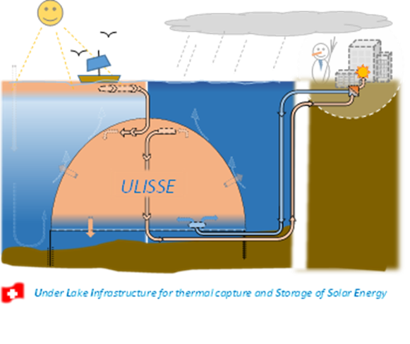
Thank you for your attention
Contact: William van Sprolant
Email: cvs-energies@mecacerf.ch
Mobile: (+41) 079 449 60 50

